Slide 1
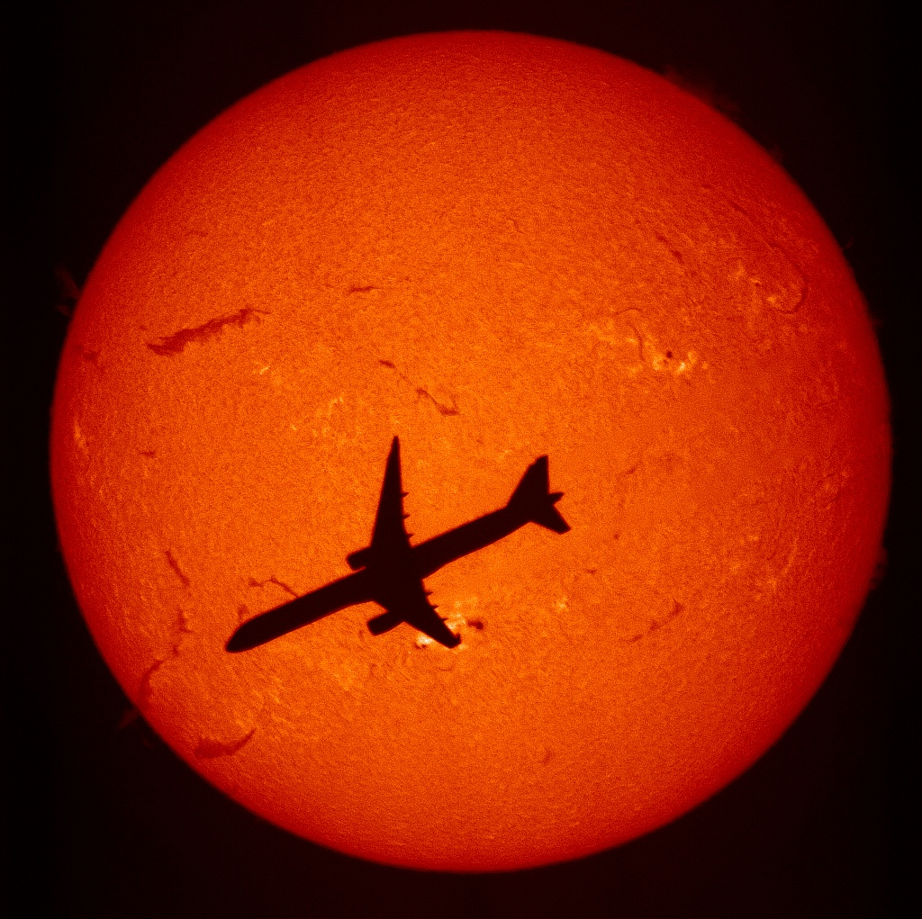
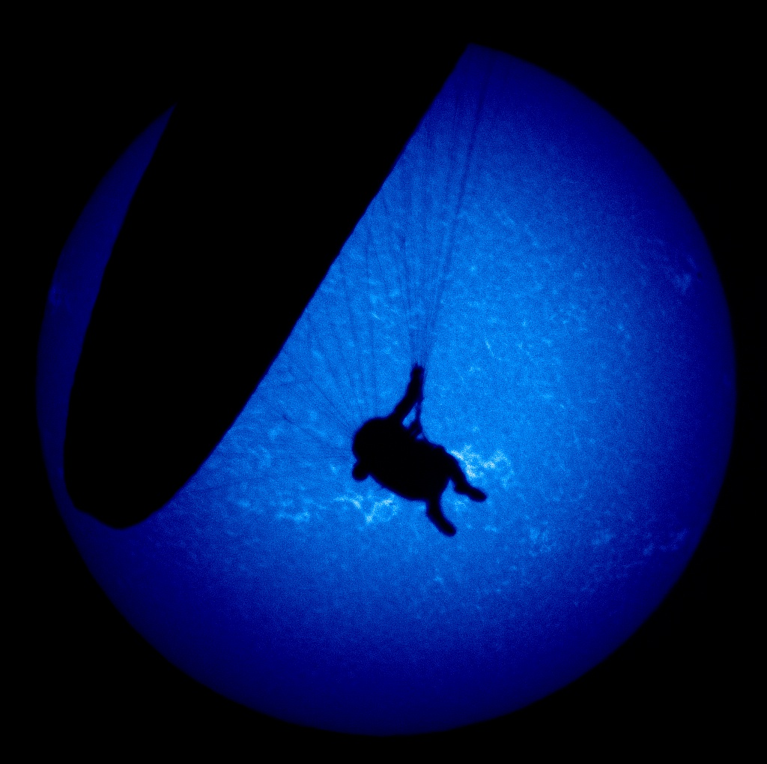
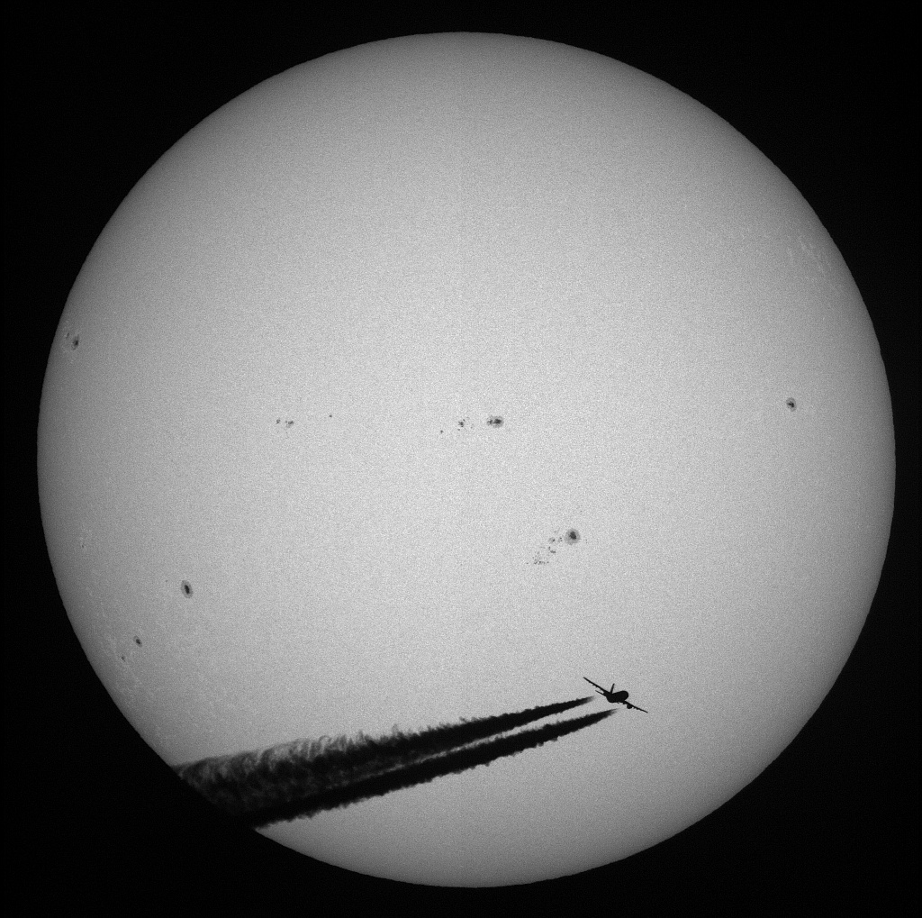
Hα, CaIIK and Whitelight Observations at Kanzelhöhe Observatory
W. Pötzi¹, A. Veronig^{1,2}, M. Temmer², G. Riegler³, T. Pock³
¹ Kanzelhöhe Observatory, Austria
² Institute of Physics, University of Graz, Austria
³ Institute for Computer Graphics and Vision, Technical University of Graz, Austria

Slide 2
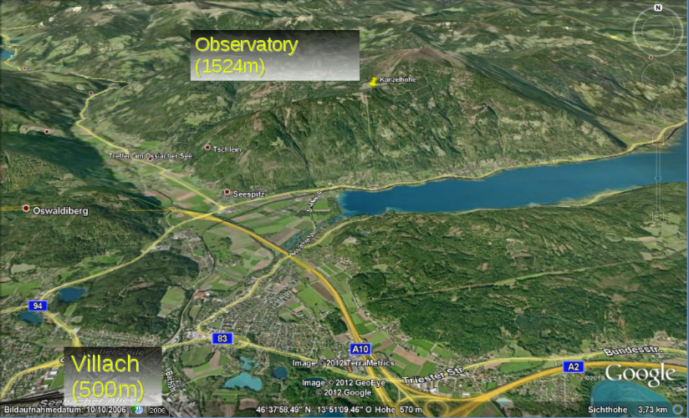

Slide 3
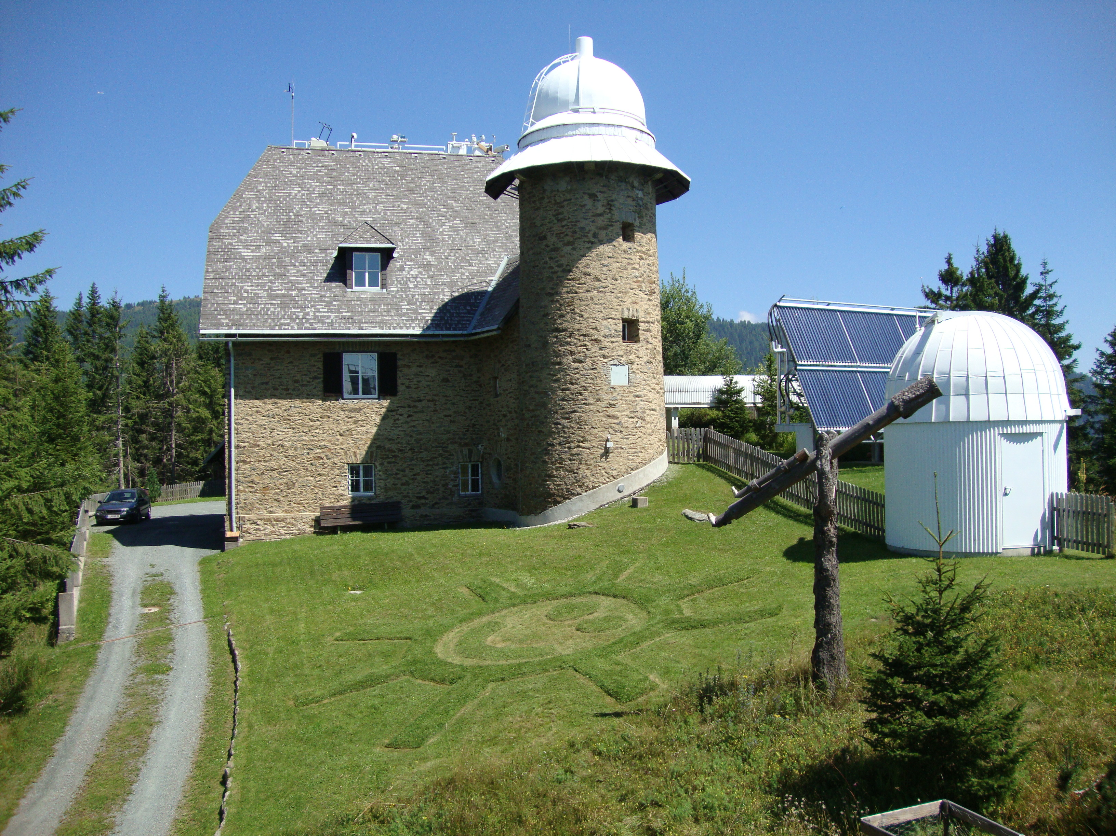

Slide 4
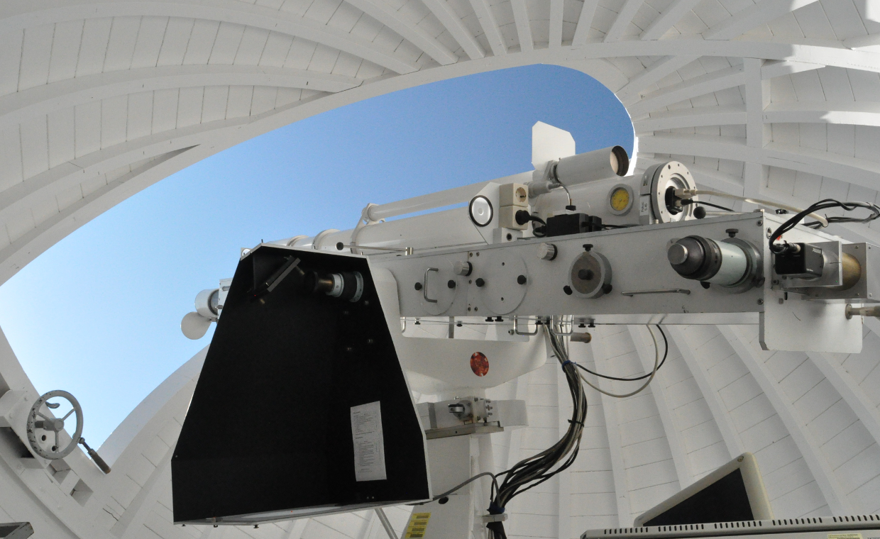
The Patrol Instrument

Slide 5
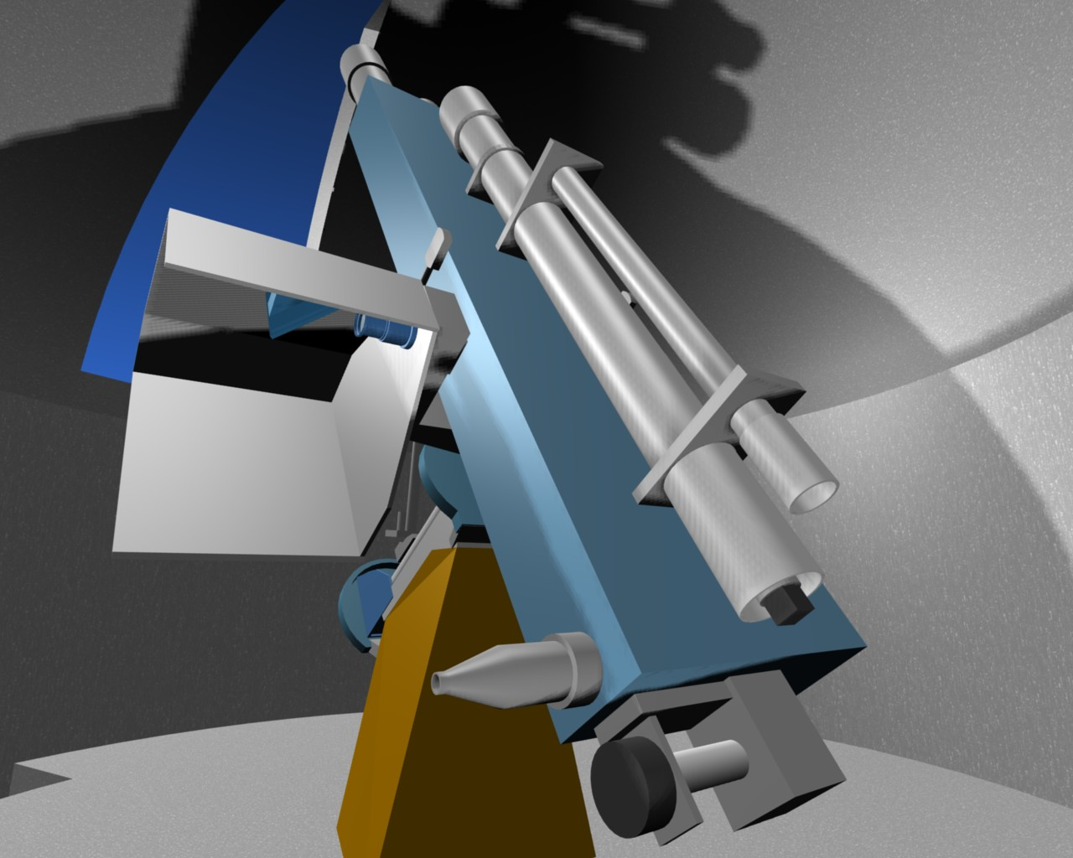
Drawing Device
Hα Telescope
Whitelight Telescope
CaIIK Telescope
Hα Eyepiece
Guiding Telescope
6
1
3
5
4
2

Slide 6
The Telescopes
Focal Length: between 1650mm and 2000mm
Diameter: between 100 mm and 110 mm
Filter: Zeiss Lyot 656.3±0.035nm, Lunt CaIIK 393.4±0.15nm, Whitelight 546±5nm
Image size: 2048x2048 Pixel, 12bit (4096 grey-scales)
Image cadence: 10 images per minute, using frame selection
Exposure time: automatically controlled, 1.5 to 35 msec
Guiding: controlled via images and microprocessor program, accuracy ca. 3 arcsec

Slide 7
The image processing Pipeline
Telescope
camera controller
work-station
RAID/archive
RAID/backup
Server@KSO
www

Slide 8
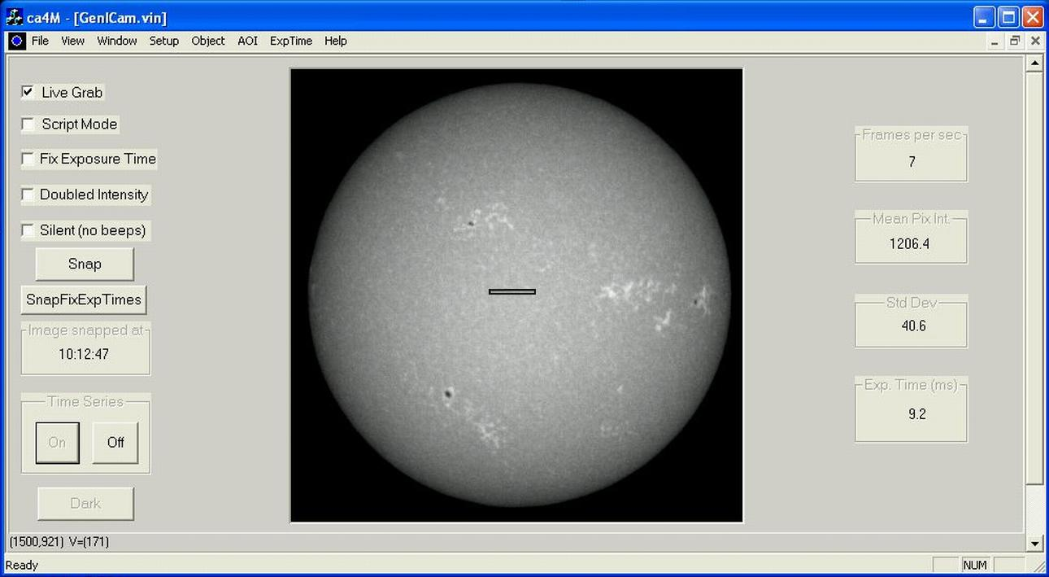
The Camera Controller
Same software and interface for all cameras!
Menu – normally not used in patrol mode
Frames/sec
Manual image snap
Overexposure (Korona)
Latest image
Patrol mode on/off
Exposure time
Dark current

Slide 9
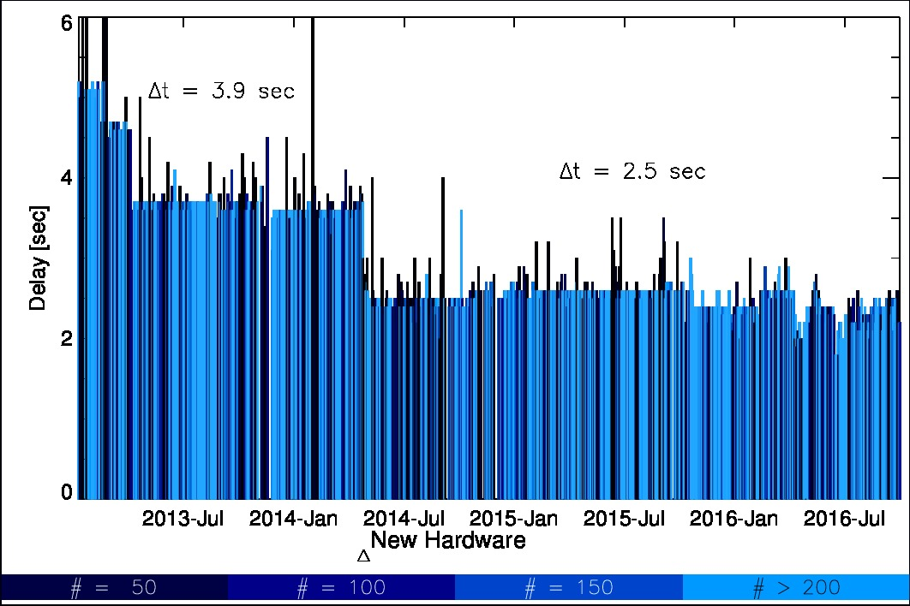
The Workstation
C++ program – 3x (for each camera)
read last camera image
test quality
bad → temporary archive
good → process image: FITS header update, JPEG for live display
Camera → 2.5 seconds → www

Slide 10
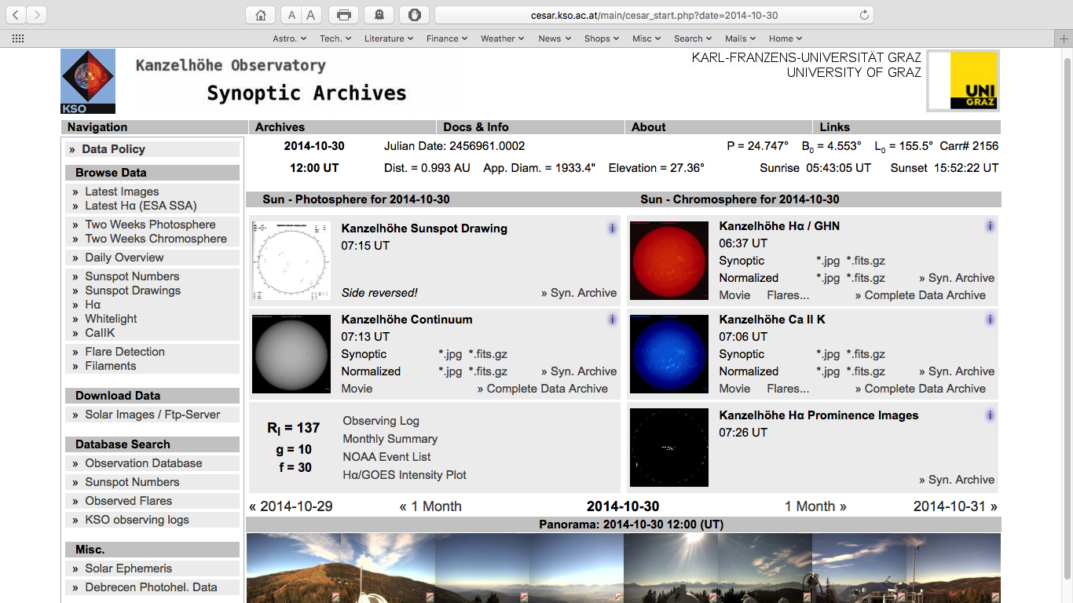

Slide 11
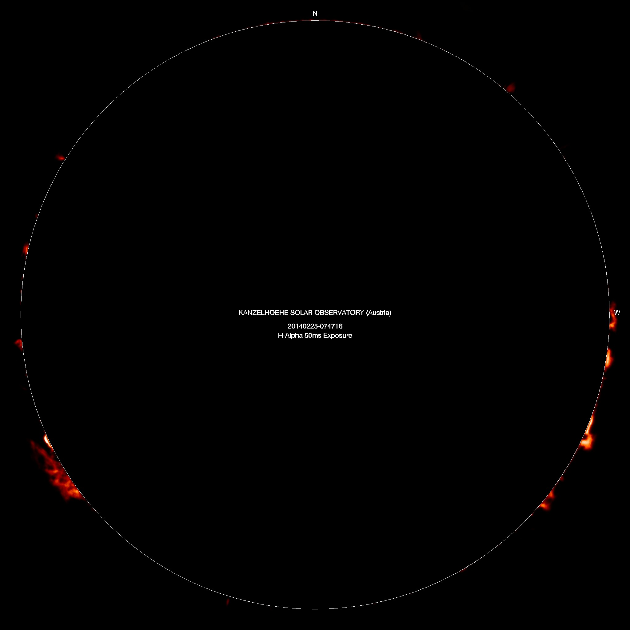

Slide 12
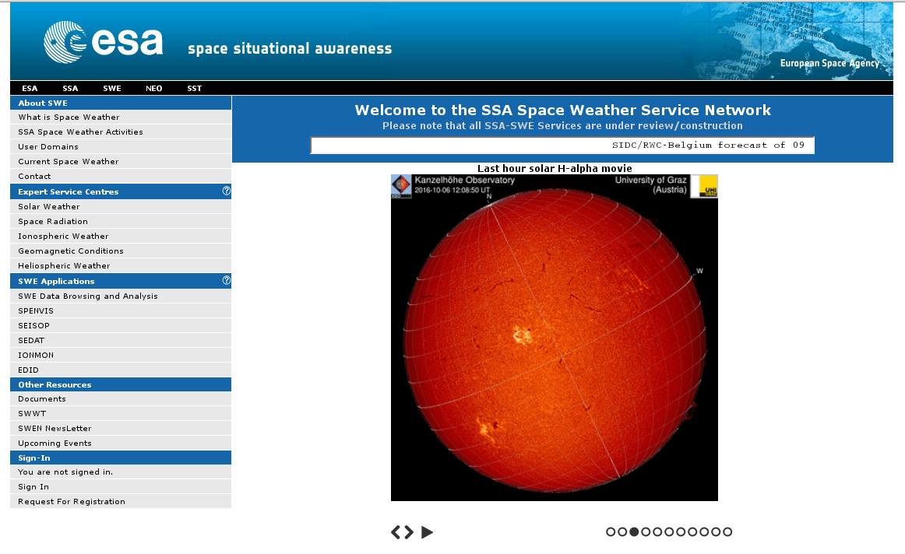
Special case: H-alpha
Workstation with GPU-processing (1500 cores)
Detection of flares and filaments for ESA – SSA (Space Situational Awareness Programme, swe.ssa.esa.int)

Slide 13
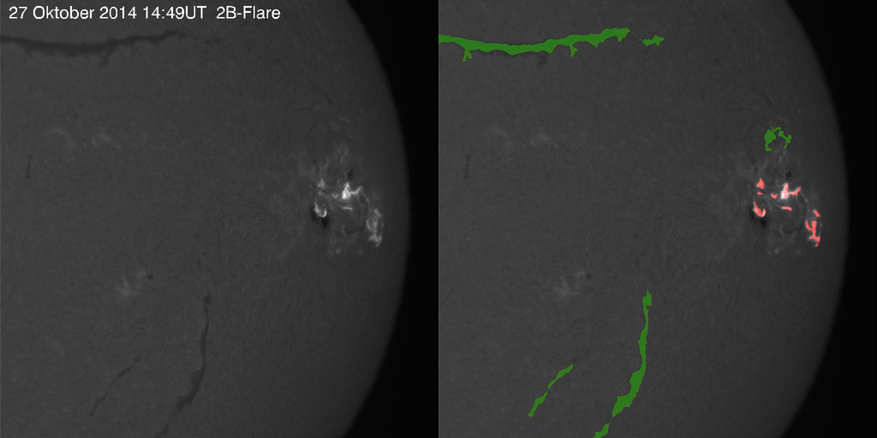
Automatic Flare and Filament detection

Slide 14
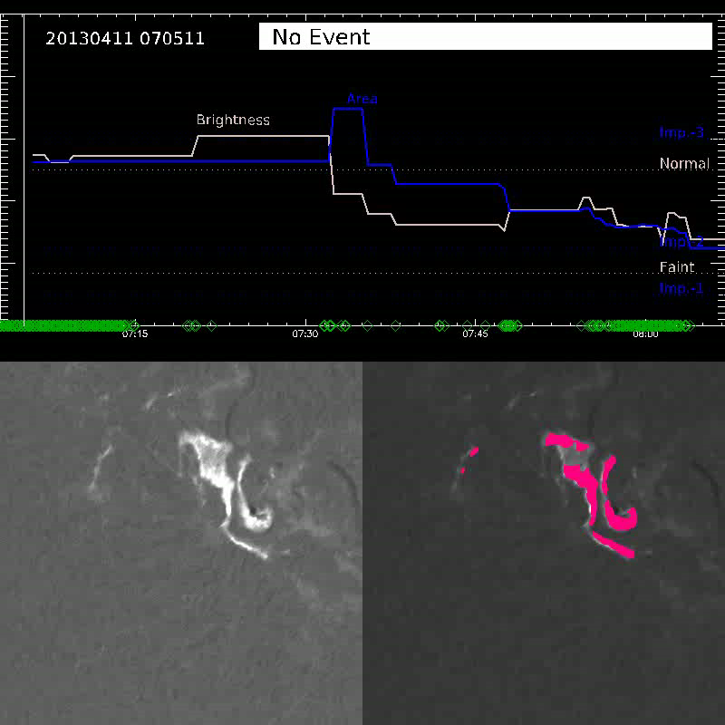
Automatic Flaredetection
Brightenings in active regions are detected and an alert is issued, when a certain threshhold in brightness and area is reached.
Imp 3
Imp 2
Imp 1

Slide 16
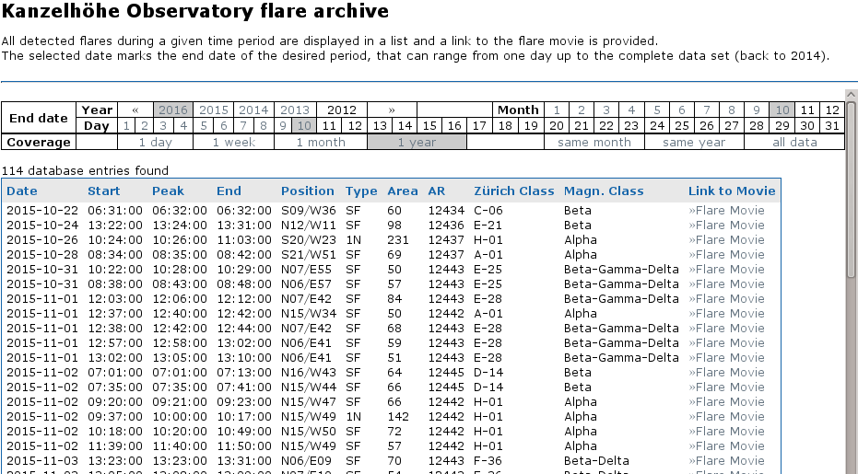
Automatic Flaredetection

Slide 18
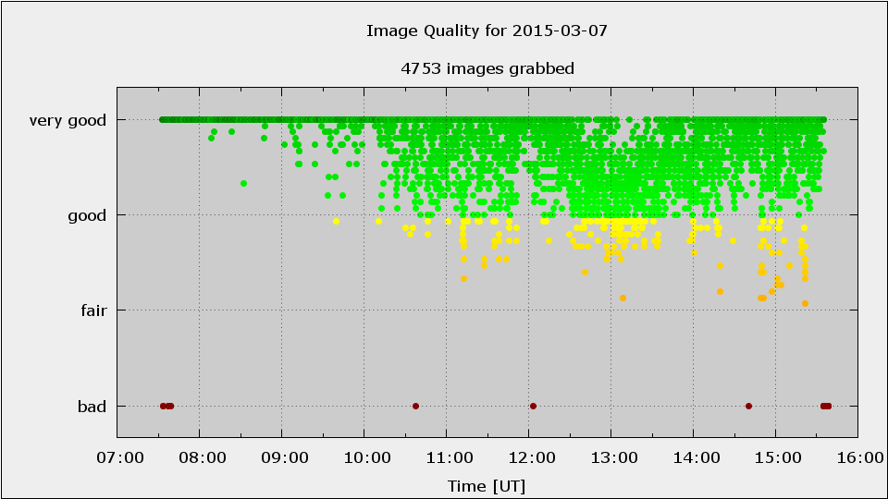
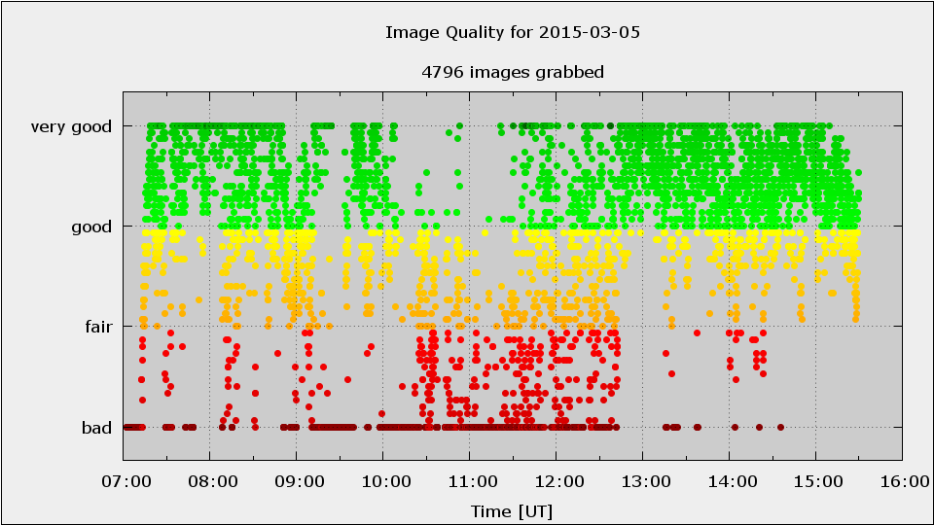
Observation Conditions

Slide 19
Patrol Observations at KSO
365/366 days a year
1500 hours of observations (2300 hours of sunshine)
300 days per year
at least 4 observers: 2 scientists 1 technician 1 maintenance staff
no technical problems! (one spare workstation, spare camera and spare camera computer)
Instructions for all colleagues to solve problems
We want to have 24/7 operation!

Slide 20
European/Worldwide Network?
GONG
6 Stations
Automatic
Identical
Live data
Global High Resolution H-alpha Network
9 Stations
Not identical
Quality?
Live data?
ISOON?
Europe: KSO, Catania, Uccle, Meudon, Pic du Midi, ...?

Slide 21
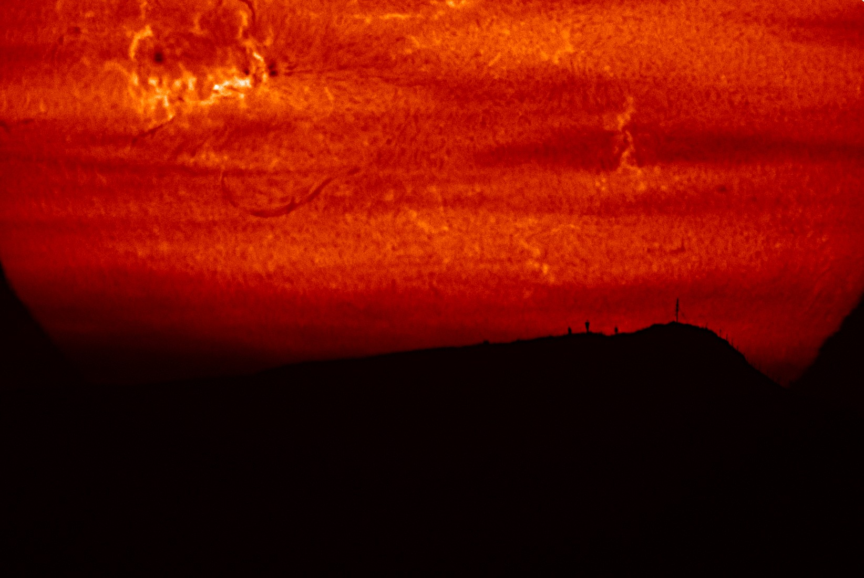
Merci

