Slide 1


The Solar Physics Research Integrated Network Group
–
SPRING
Markus Roth,
Sanjay Gosain,
Frank Hill, Michael Thompson
Synoptic Ground-based Solar Observations for Space Weather
Nice, October 18, 2016

Slide 2
The Need for Synoptic Observations of the Sun
Long term monitoring of the solar magnetic fields
  to understand solar dynamo
  evolution with solar cycle (polar and active region fields)
  Active region evolution for space weather studies
  surface flows via feature tracking
Long term monitoring of velocity fields
  subsurface flows via helioseismology
  solar cycle variations and relationship to solar dynamo
  Flows beneath emerging flux regions and active regions for space weather studies
Context imaging for next generation high-res telescopes such as DKIST and EST
  Large scale effects (flares, filament eruptions) of small scale events such as flux emergence.
* Hill, F. et al. Space Weather, 11, 392, 2013
* Elsworth, Y . et al., Space Sci. Rev., 2015, 193,137

Slide 3
Big Questions
  What is the origin of the solar activity cycle?
  What is the structure, dynamics, and energetics of the solar atmosphere?
  How does the Sun drive space weather?
  What are the signatures of solar activity?
  Detailed questions for a synoptic network
    What is the magnetic field in the chromosphere and photosphere?

Slide 4
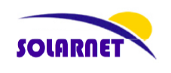
SPRING is part of SOLARNET
Solarnet is an Integrated Activity (IA) funded by the European Union’s Capacities Programme under Framework Programme 7:
Work Programme includes:
Networking Activities (NAs)
Transnational Access and Services (TAS)
Joint Research Activities
  Tools for innovative data handling
  Advanced instrumentation development
  Wavefront control: turbulence characterization and correction
  Synoptic observations:
  Solar Physics Research Integrated Network Group (SPRING)
Coordinator of Solarnet: Manolo Collados (IAC)
Project Duration: April 2013 – March 2017

Slide 5
Synoptic observations:
Solar Physics Research Integrated Network Group (SPRING)
Objective: Development of instrumentation for large field-of-view observations of the Sun with a network of solar telescopes in support of observations with existing
high-resolution solar telescopes (either isolated or in a coordinated way).
Technical Requirements / Future synoptic telescopes should provide
Full-disk Doppler velocity images
Full-disk vector magnetic field images
Full-disk intensity images
Measurements of quantities relevant for space weather
Provide the above data products in a variety of wavelengths
Provide the above data products at a high cadence (≤ 60 seconds)
Provide the above data products at a spatial resolution of 1” (0.5” pixels)
Provide the above data products at least 90% of the time
Provide the above data products for at least 25 years
Complement space missions
Participants:
KIS, IAC, INAF, MPS, QUB, AISAS, AIASCR, IGAM, UoB, NSO, HAO

Slide 6
SPRING Activity – Three Working Phases
Science requirement study
  describe the supporting data required by high-resolution observing programs
  the scientific objectives to be achieved by high-quality synoptic observations
  study of the relation with other existing ground-based solar observation networks
Science Requirement Document (SRD) is available on
http://www.science-media.org/paperPage.php?v=251

Slide 7

Science Requirement Document
http://www.science-media.org/cid/spring2016 -> papers

Slide 8
Working Groups
  Group 1: Synoptic magnetic fields
  Sunspots (problems with cool atmospheres)
  Active regions
  Quiet Sun magnetism
  Synoptic Hanle Observations
  Head: A. Pevtsov
  Group 2: Solar seismology
  Waves (solar interior)
  MHD waves (magnetoseismology)
  Velocity field inside and on the Sun
  Head: R. Jain
  Group 3: Transient events
  Flow of energy through the solar atmosphere (3,2)
  Transient events
  (flares, prominences, CMEs)
  Head: M. Sobotka
  Group 4: Solar Awareness
  TSI / SSI
  Space Weather (4,3)
  Space Climate
  Sun-as-a-star
  Head: I. Ermolli

Slide 9
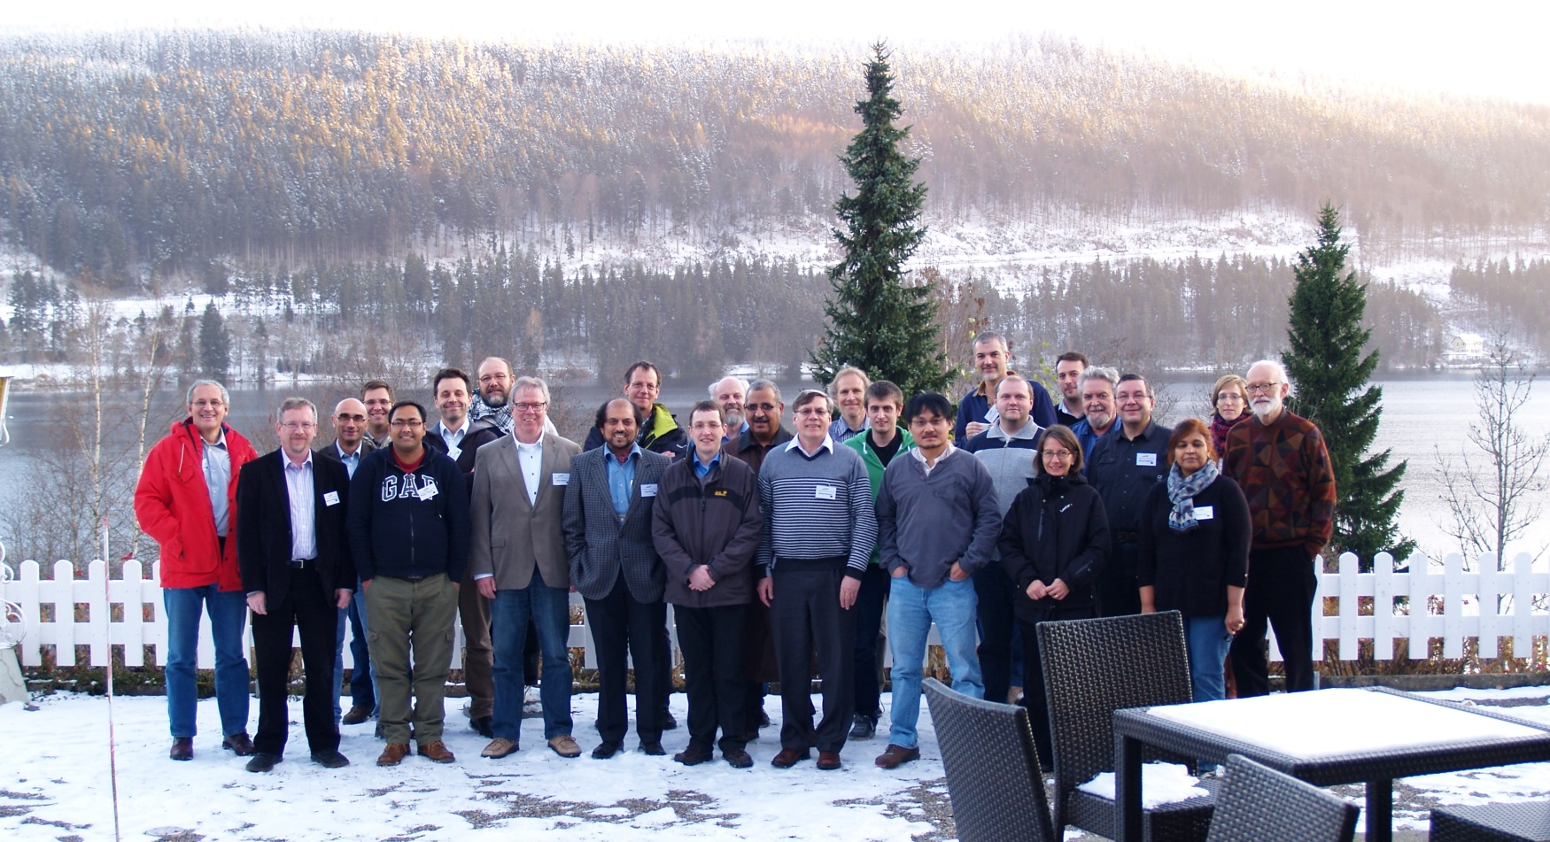
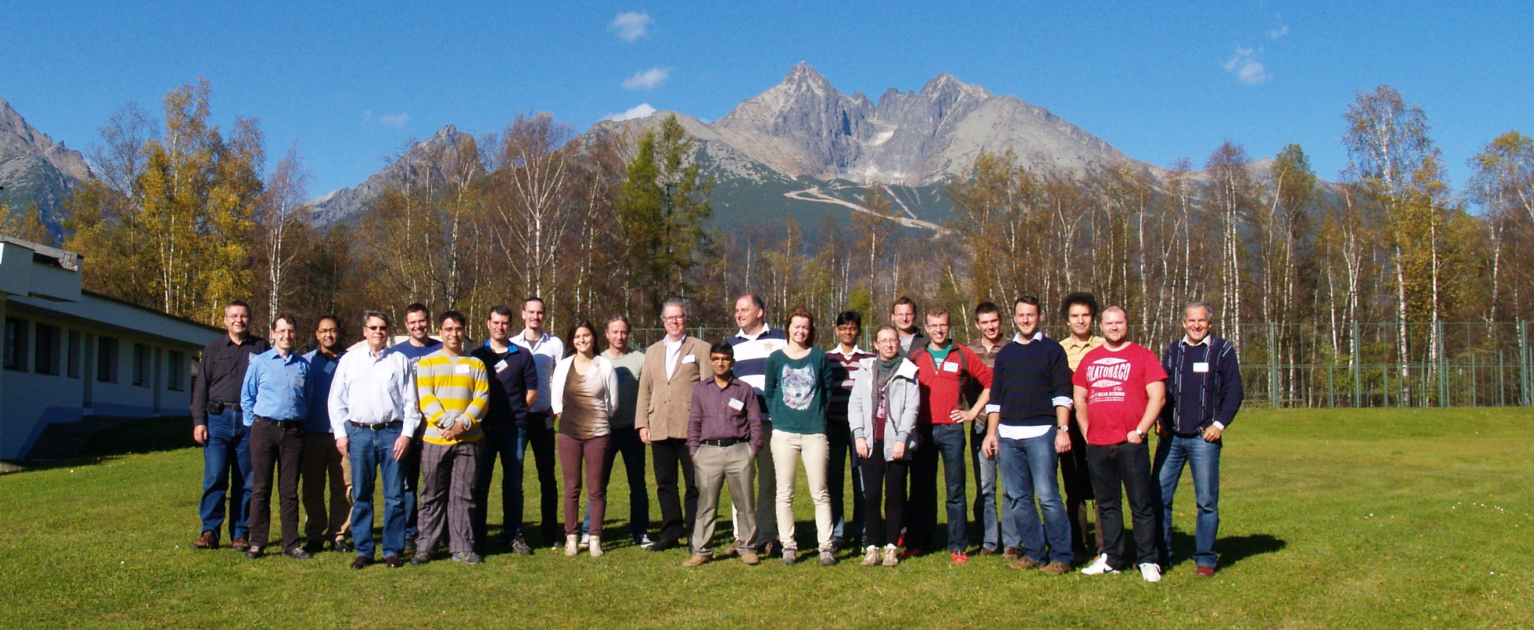
Workshops
Synoptic Network Workshop, 22. – 24.04.2013, Boulder, USA
1st SPRING Meeting, 25. – 28.11.2013, Titisee, Germany
2nd SPRING Meeting, 25. – 28.11.2015, Tatranska Lomnica, Slovakia
3rd SPRING Meeting, 15.-17.05.2016, Boulder, USA

Slide 10
Instruments Wishlist
Vector Magnetograph
Broad band imager
Disk-integrated spectrograph (high spectral resolution)
Multi-lambda-helioseismic-Doppler-imager-and-magnetic-field
Multi-lambda-vector-magnetometer
Irradiance device (resolved)

Slide 11
Expected Improvements:
Magnetometry
Multi-line high-resolution magnetic observations of the Sun
Several Advantages:
3-D magnetic topology of active region magnetic fields
Improved coronal field extrapolations due to force-free behavior in upper layers of solar atmosphere.
First ground based continuous vector magnetometry for near real time space weather predictions.
Flare related changes in magnetic fields and electric currents in the chromosphere.
Long-term magnetic field records with improved spatio-temporal resolution.

Slide 12
Expected Improvements:
Helioseismology
Multi-line high-resolution Doppler observations of the Sun
Several Advantages:
Improved accuracy and precision of helioseismic mapping, in vicinity of active regions (Hill 2009).
Reduction in systematic errors (i.e., improved accuracy) (Baldner & Schou 2012)
Also, multi-height observations are useful for seismic mapping of solar atmosphere (Wisniewska et al. 2016, Finsterle et al. 2014, Nagashima et al. 2009).
Transportation of convective energy through solar atmosphere
(Jefferies et al 2006).
….. more details in the review by Elsworth et al., 2015, Space Sci. Review, 193, 137

Slide 13
SPRING Activity – Three Working Phases
2. Feasibility study
2.1 Instrument design concepts
  Definition of technical requirements for the instrument, based on scientific goals
  Definition of alternatives of instruments concepts
To be studied:
Adaptive optics or other image stabilizing/enhancement technology
Observations in at least the following spectral lines: Ni I 6768, Fe I 6301/2, Na D, H-α, Ca K, Ca H, He10830,Fe I 6173 and Fe I 1.5 micron.
High-speed image post-processing / High-speed real-time data access
→ first concepts to provide line-of-sight magnetic field and velocity maps
Location of telescopes for setting up a network mode → BiSON/GONG experience
Possible instruments concepts:
Filtergraph, Spectrograph and Interferometer, each one with different options
→ under study
2.2 Operational concepts
  Develop operational ideas (remote operations, data pipelining, delivery of real-time data to operating telescopes)
  Develop high-speed image post-processing routines

Slide 14
Narrow-band & Broad-band Filtergrams
Existing instruments:
SOLIS FDP, CHROTEL, Kanzelhöhe, NAOJ, Kodaikanal, HAO, GONG
Goal: Improve spatial resolution for these images
Options:
1. Implement Fast Image stabilization (with SOLIS FDP)
2. Explore fast camera (4kx4k at 200 fps)
3. Use existing 2kx2k @ 200 fps, fast cameras for acquiring broadband filtergrams and apply reconstruction methods such as speckle imaging, MOMFBD and Phase-diversity.
- Post processing methods need to be developed for highly parallelized (for near real-time) processing of iso-planatic patches over the fulldisk.
→ Feasibility is currently being explored at NSO and KIS.

Slide 15
Filtergraph v/s Spectrograph
Cadence and spatial resolution requirements make it clear that
filtergraph is a suitable choice
Advantages:
  Cadence of data can be higher for filtergraph at the cost of spectral resolution.
  Spatial resolution can be better due to use of post processing techniques.
Disadvantages:
  Spectral degradation due to seeing variations during scans.
  Solution: Simultaneous broadband imaging can be used to reconstruct the spatial variations in the scans via reconstruction methods such as destretching.
Spectrograph systems give instantaneous spectra
However: Time-varying seeing → Spatial degradation during long scan times,
Post facto techniques cannot be applied
Non simultaneity of fulldisk rules out usage for helioseismology

Slide 16
Filtergraph Approach to SPRING
1. Michelson Interferometer: Examples: GONG, MDI, HMI
Advantage: large FoV, stable, compact
Disadvantage: Not suitable for multi-wavelength work as proposed in SPRING
2. Lyot type filters: Examples: UBF, Chromag
Advantage: large FoV, high contrast
Disadvantage: Requires lot of Calcite, Dual beam polarimetry not possible, slow tunability, low transmission for narrow passbands
3. Magneto-optical-filter : Examples : MOTH, GOLF
Advantage: stability, large FoV
Disadvantage: Not suitable for multi-wavelength work as required in SPRING
4. Fabry-Perot Interferometer: Examples: IBIS, CRISP
Advantage: Large wavelength range, rapid tunability, high transmission
Disadvantage: Field dependent passband shift, ghost reflections, long term drifts.

Slide 17
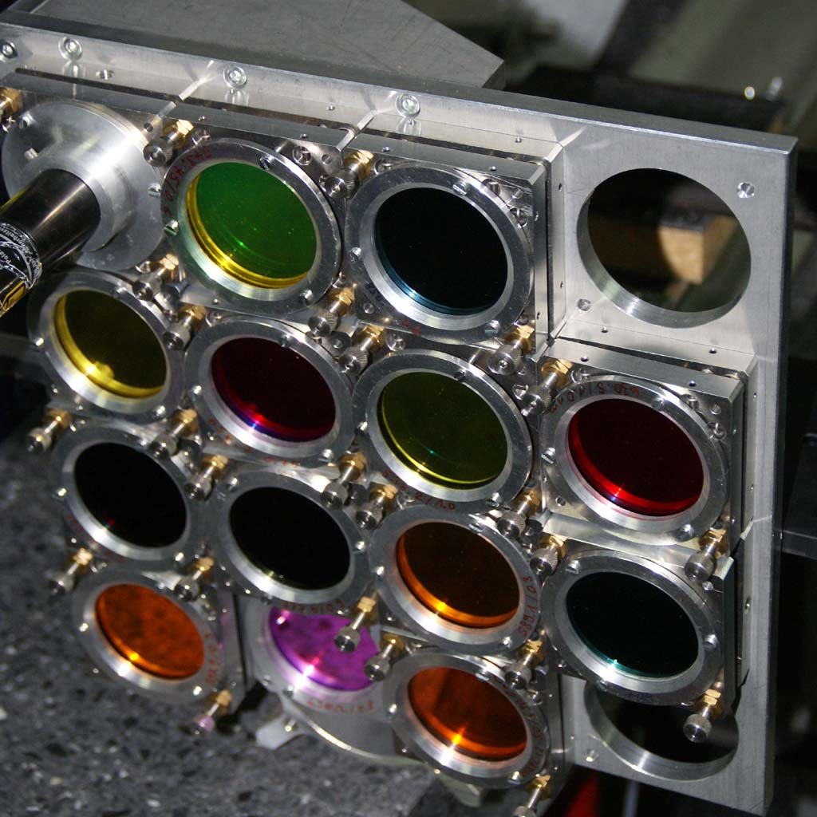
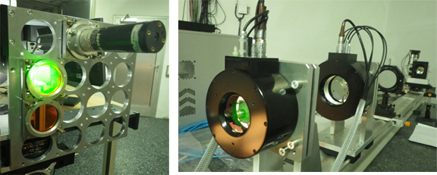
Filtergraph Concept (Feasibility)
Demonstration Instrument at Vacuum Tower Telescope
HELioseismic Large Region Interferometric DEvice (HELLRIDE, Staiger 2011)
Dual Etalon system designed for multi-line observations over 100 arcsec FoV
The fast prefilter positioning system is used for minimizing the dead-time between subsequent spectral scans.
HELLRIDE was tested for feasibility of fulldisk measurements during May 2015 at VTT in collimated setup.
CCD prefilter Lens FP2 FP1

Slide 18
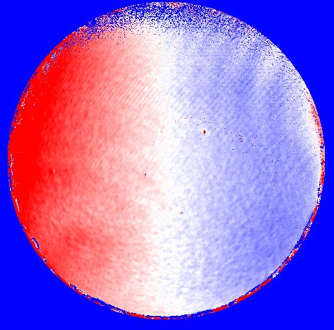
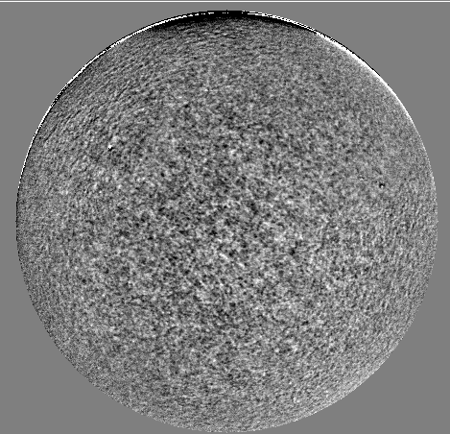
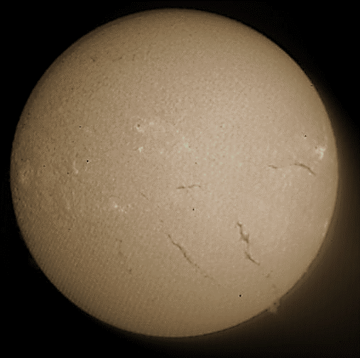
Filtergraph (Feasibility)
Sample preliminary HELLRIDE observations of fulldisk with Fe 6302 line
Long time series possible: instrument stable enough.
Future tests in the next weeks:
  →Implement a diffuser + lens system to obtain flat-fields
  →Online spectral drift monitoring system: using Laser
  →Simultaneous white-light camera for image restoration.
  →Polychromatic Polarimeter: to obtain LOS/vector magnetic and velocity maps in various lines.

Slide 19
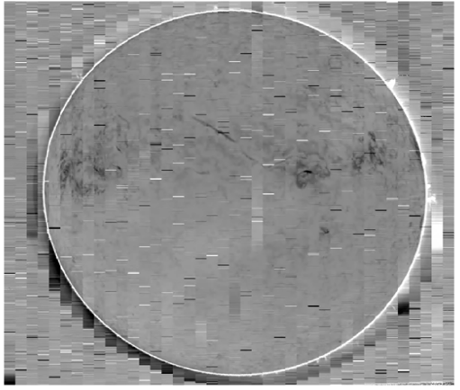
Spectrograph (Feasibility)
Slit spectropolarimeter: e.g. SOLIS/VSM
  Cadence is ~20 minute for full disk vector magnetogram with single slit.
  Multiple-slit design can be implemented for improved cadence
Haosheng Lin from IFA, Hawaii carried out multi-slit demo.
Observations with NSO DST for Stokes-I in He 10830,
achieving cadence of 1 minute with 35 slits.
Sample 35-Slit Full Disk Spectral Image
Reconstructed Line Core Image

Slide 20
SPRING Activity – Three Working Phases
3. Development and operation study
  3.1 Trade-off analysis
  Combination of instruments and cameras
  Camera set-up and development, particularly in large format and high cadence
  Select less than 3 instrument concepts to be detailed and cost estimated
  3.2 Network operation and data delivery to high-resolution telescopes
  Network operation and performance and on-line data access
  Deepening on the studies on data processing and merging, including automated control, data pipelines processing on clusters of CPUs or possible use of Graphical Processing Units and data delivery
  → being explored

Slide 21
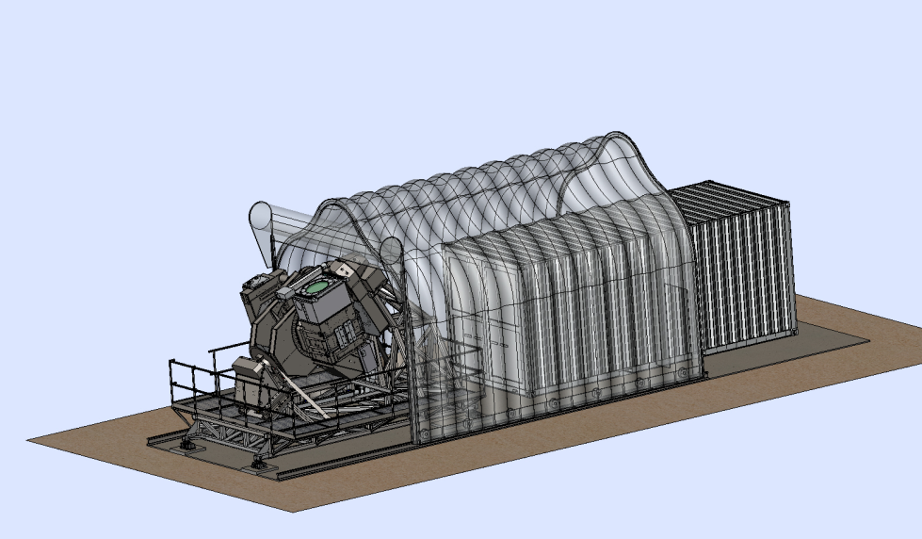
Final Deliverable
Final proposed instrument concepts and operational plan to be delivered end of March 2017
Will contain a summary of our results with our suggestion on how to set up a new synoptic network
+ Collection of technical studies that lead
to our conclusions

Slide 22
Summary:
Invitation to Contribute to Discussion & Work
Discussion of possible plans for a future full-disk telescope and a platform to carry multiple instruments has become a world-wide effort
Physics
  Big questions → What are the physical quantities to be measured?
  Multiple-wavelength observations → What can be learned from them?
Requirements
  Spatial resolution
  Temporal resolution
  Selection of wavelengths → How to observe them with one setup?
Instrumentation
  Several instruments at one telescope vs.
  several telescopes at one observatory
  Need for a network
  Joint ground and space observations

Slide 24
Expected Duty Cycle & SNR
Estimated from the BiSON stations

Slide 25
Seeing quality at the GONG sites

Slide 26
Seeing quality at the GONG sites

Slide 27
Seeing quality at the GONG sites

Slide 28
Seeing quality at the GONG sites

Slide 29
Seeing quality at the GONG sites

Slide 30
Seeing quality at the GONG sites

Slide 31
Seeing quality at the GONG sites
At all sites seeing is between 2 – 8 arcseconds
  Depending on day-time and season
Improvement:
  GONG is on the ground, i.e. no tower
  Influence of building (GONG shelter) is not clear
  → compare seeing at GREGOR/VTT & GONG-Izana
  Higher temporal cadences
  Central question:
  What could be gained by a bigger telescope?

