Slide 1



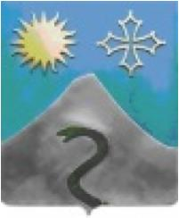
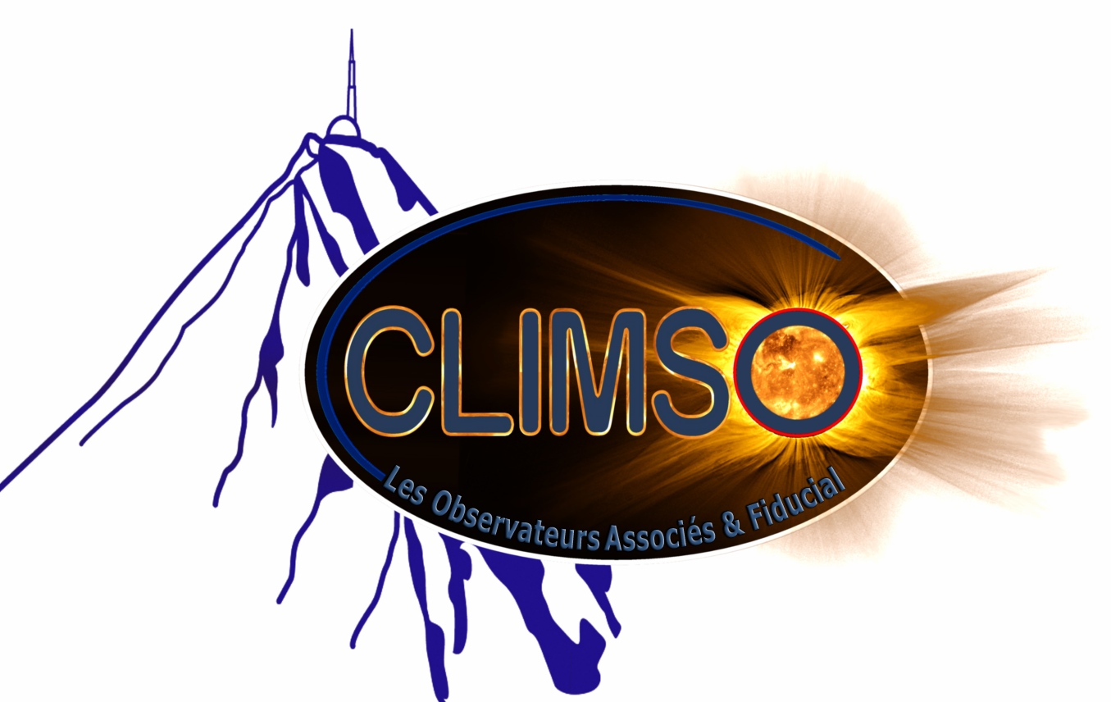
CLIMSO at Pic du Midi
Laurent Koechlin
IRAP, Université de Toulouse, CNRS

Slide 2
CLIMSO at Pic du Midi
  The instruments
  Solar survey
  Since 2015: Solar corona with C2
  Space weather
  New developments on C1 and C2
  Data bases

Slide 3
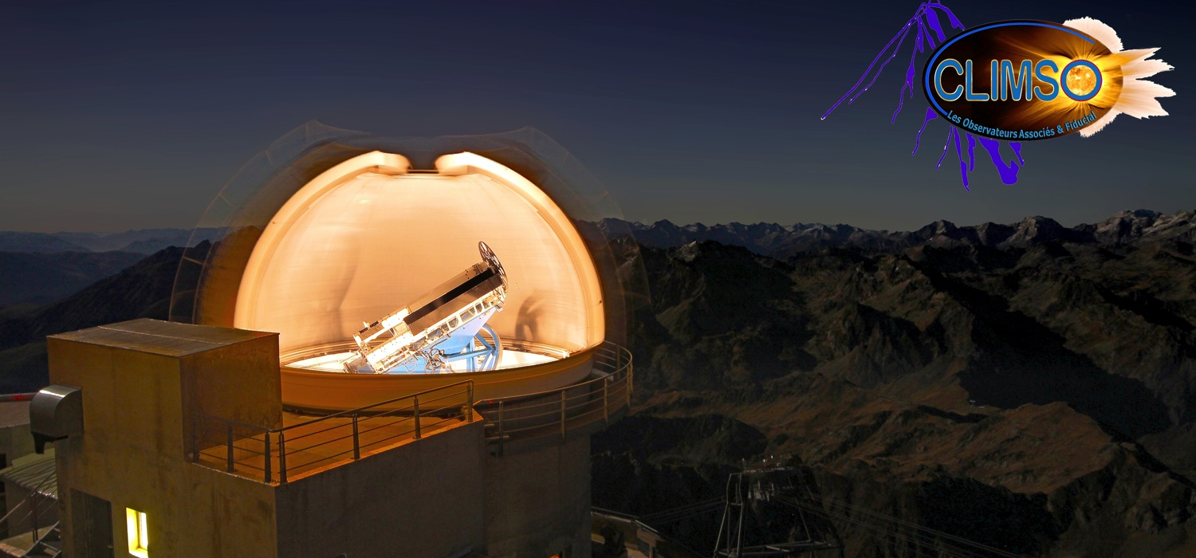
CLIMSO instruments

Slide 4
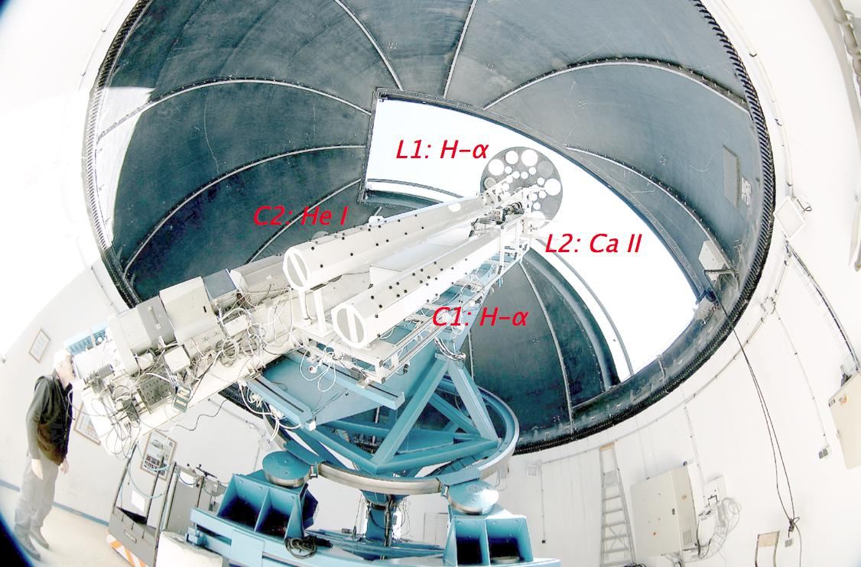
Four solar instruments on the same mount
Two coronagraphs (C1: H-α, C2: He I) and two solar telescopes (L1:H-α, L2: Ca II)

Slide 5
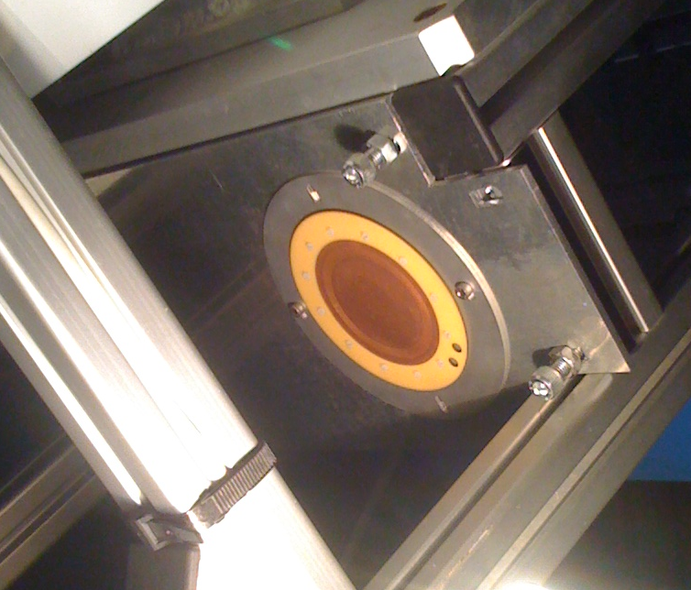
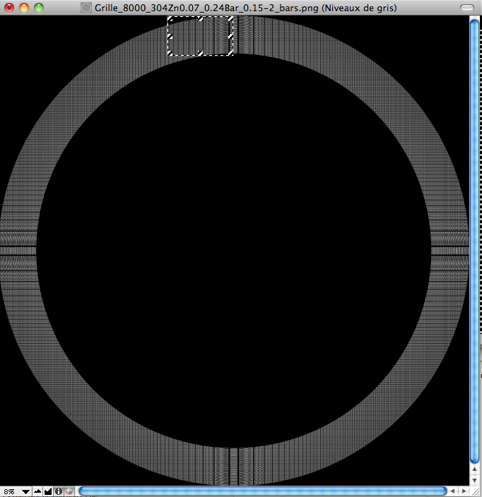


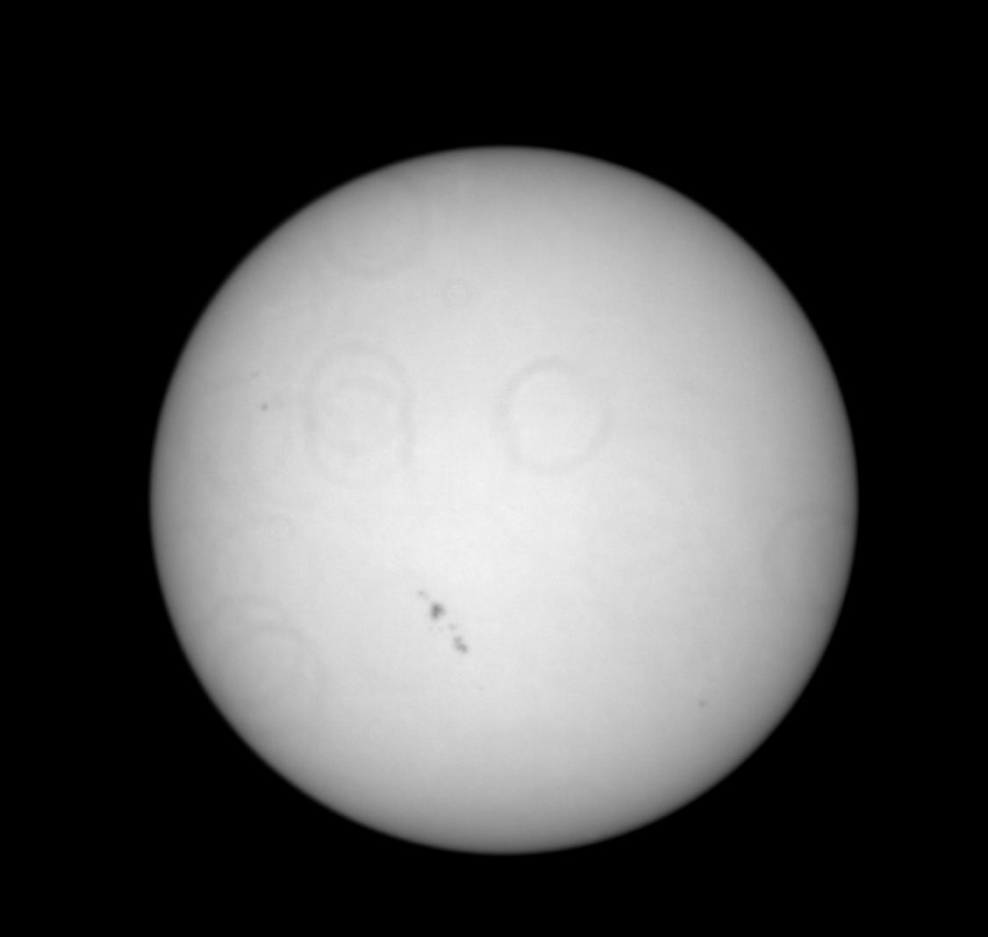
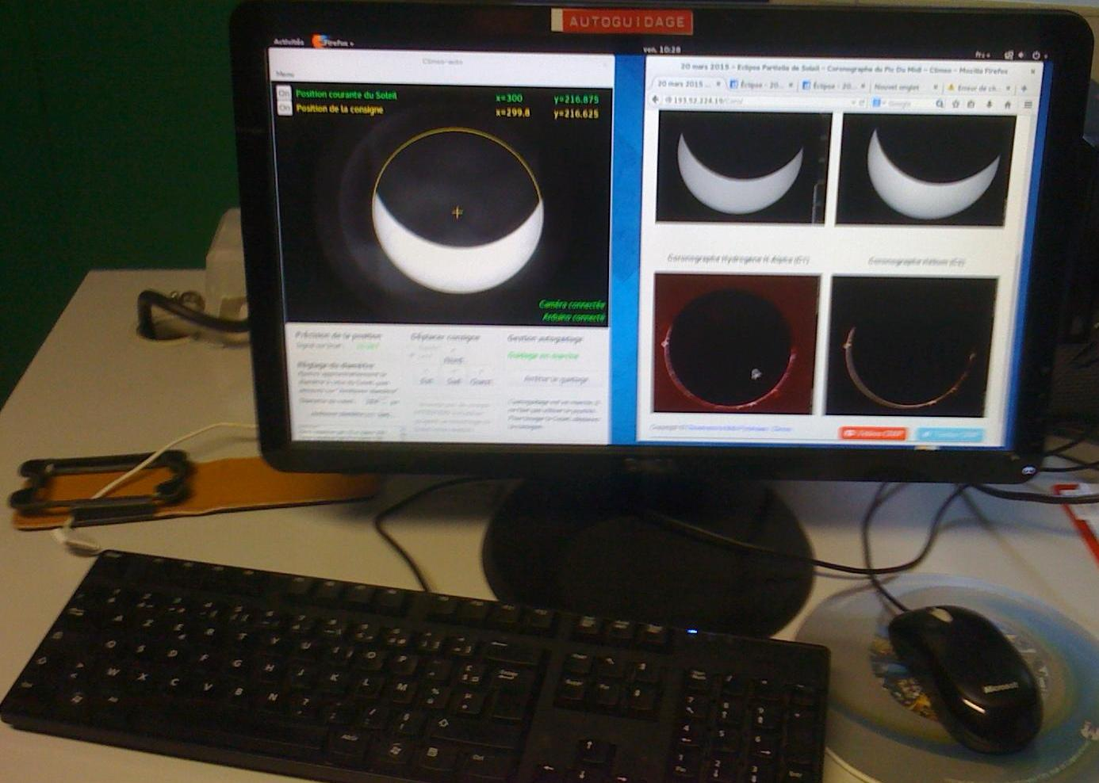
A fifth instrument for high precision autoguiding
Diffractive imaging: no lens, no mirror, but a binary aperture carved into a copper plate
Image of a
point source
(enlarged)
Image of the Sun
fed to the autoguider
High precision guiding, even if
only part of the Sun is visible.
Above: during a partial eclipse.

Slide 6
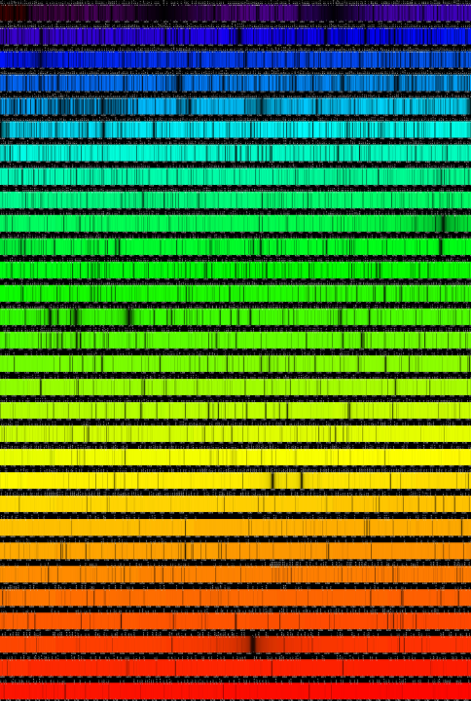
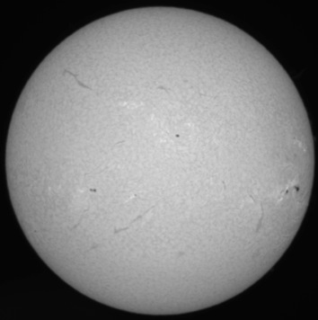
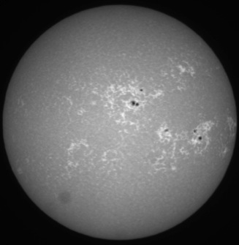
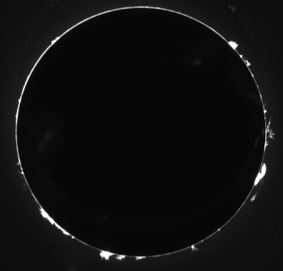
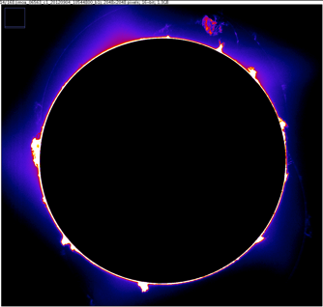
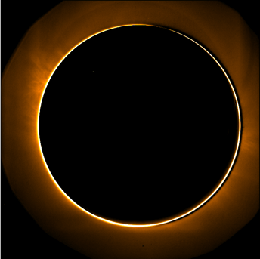
Images from CLIMSO at Pic du Midi :
5 spectral channels sampled
H-α (656.28 nm)
sampling 1 minute
Ca II (393.37 nm)
sampling 1 minute
solar spectrum(source :
J.-M. Malherbe web pg
I.R.
He I (1083.0 nm)
prominences
sampling 1 minute
H-α (656.28 nm)
prominences
sampling 1 minute
Fe XIII (1074.7 nm)
CORONA
sampling 30 minutes
Presently "Service d'observation"
of the French Institut National des Sciences de l'Univers

Slide 7
Solar survey at Pic du Midi
Since 2007: spectral channels H-α; He I; Ca II
  images: 1 per minute per channel, and the films made from them;
  Field: 1.3 solar diameter, resolution 1 arc second (2048*2048 pixels)
    whole solar disc, prominences, corona
  soon to come: velocimetry, polarisation, magnetic field maps:
    will be presebted by Arturo Lopez Ariste

Slide 8
Solar survey at Pic du Midi
These data are freely available through various channels
  direct at web page: www.climso.fr
  through VOs : VESPA, EPN-TAP Europlanet
  synergy with MLSO : 12 hours time zone difference

Slide 9
Solar survey at Pic du Midi
Particularity of CLIMSO compared to other survey facilities:
  Close collaboration with a large group of 90 volonteer astronomers
    financial support from Univ-Toulouse, CNRS, and from a private company
  Over 50/52 weeks covered, weather allowing
  Large direct public audience: 4500 visitors / year in the dome !
    drastic cleaning (dust) constraints !
  and last but not least: Space Weather alert

Slide 10
Solar survey at Pic du Midi
The value of a survey is linked to:
Quantity and quality of data:
calibration in physical units, contrast, résolution, regularity of frame rate.
Duration if possible a large number of solar cycles;
Satbility of acquisition conditions: wavelength, spatial and temporal sampling;
Ease of acsess through data bases, free access, no embargo
We calibrate our images of the solar disc in H-α and Ca II:
Emittances in W m^-2 sr^-1, in a plane tangent to the surface of the Sun
We will soon calibrate too the images of the prominences in H-α
but we need time to implement this calibration on the He I and Fe XIII channels.

Slide 11
Films
Disc: H-α
Disc: Ca II

Slide 12
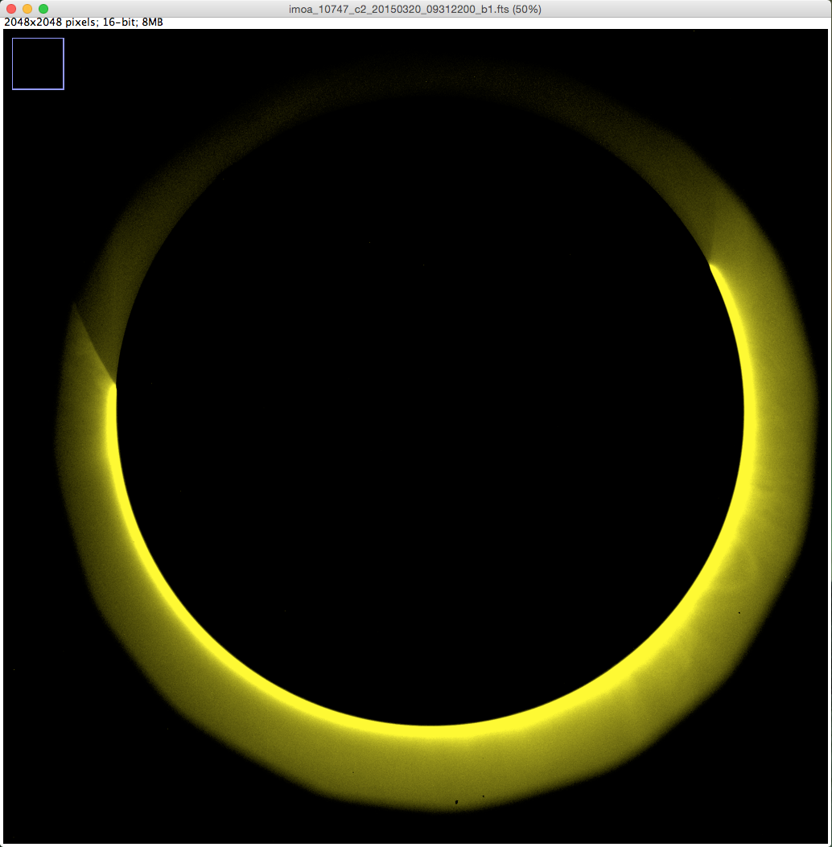
First images of solar corona
couronne Fer XIII
What is this?
loop
2015-03-20

Slide 13
Films
Prominences H-α
Corona Fe XIII

Slide 14
Space weather
The solar disc and prominences are seen in real time by the operators.
they are committed to inform of any large or unusual phenomenon

Slide 15
Future developments
2016
- renewal of the cameras and acquisition software
2017
- Lucky imaging thanks to the faster cameras
- Synchronous wavelength modulation (Arturo Lopez Ariste)
will improve contrast and allow more observing time at constant weather conditions
- renewed architecture of our data base
- more calibraed channels
- films from the images at "less degraded" resolution

Slide 16
Future developments
2018, ...
Velocimetry: disk and prominences
  Polarimetry for the Fe XIII or Fe XIV corona images,
  Polarimetry and magnetic fields (talk by by Arturo Lopez Ariste)

