Slide 1


SuperDARN data and ionosphere modelling perspectives at IRAP
Aurélie Marchaudon, Pierre-Louis Blelly, Frédéric Pitout,
Maxime Grandin (*), Mikel Indurain, Etienne Foucault
IRAP, CNRS and UPS
(*) also at Sodankylä Geophysical Observatory, Finland
Synoptic Ground-Based Solar Observations for Space-Weather– 20/10/2016 - Nice

Slide 2
Plan
Introduction
SuperDARN presentation
Foreseen studies and developments

Slide 3
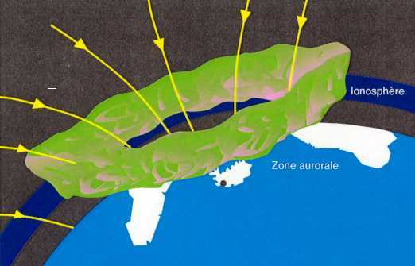
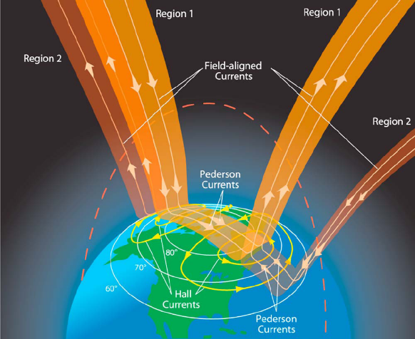
Fundamental role of the ionosphere for Space Weather
→ Converging region of interaction mechanisms between the Sun and the terrestrial environment
Closure of magnetospheric currents
Energy dissipation (Joule heating, particles precipitation
Large spatio-temporal variability
Active role of the ionosphere (inductive effects)
→ Critical effects on human activities
Dispersive properties over the electromagnetic waves (perturbation and/or blackout of radio communication)
Production of plasma patches and bubbles (GNSS signal scintillation)
Ground induced currents (interference with electrical power transmission)

Slide 4
Challenges for characterization of the ionosphere medium
→ simplified but realistic models
→ for real-time and ready-for-operations activities
  through available data assimilation (GNSS, SuperDARN, ionosondes, incoherent radars, satellites …)
  through direct modelling (e.g.: waves in HF and VHF range) to reproduce the observations
IRAP available tools and expertise (science):
  IRAP Plasmaphere-Ionosphere Model IPIM
  all latitudes and 90 km < alt < 22 000 km (plasmapause)
  Low ionosphere photochemical model IONOS
  all latitudes and 60 < alt < 90 km (D-Region)
  Coherent and incoherent radars (SuperDARN, EISCAT) data expertise
Tools/expertise still to develop (applications):
  GNSS data expertise
  Electrodynamics assimilation model from IMM (SuperDARN, AMPERE, OVATION)
  Tomography (GNSS, SuperDARN) by direct modelling of waves propagation
  Static and global ionosphere model

Slide 5
Plan
Introduction
SuperDARN presentation
Foreseen studies and developments

Slide 6
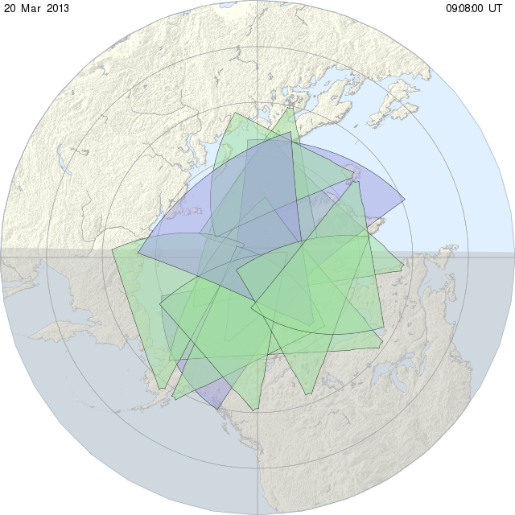
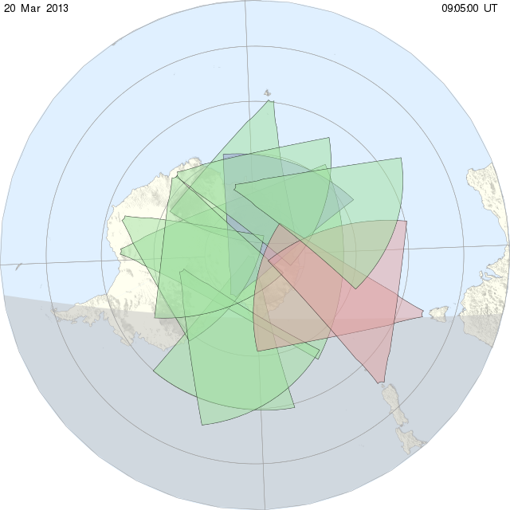
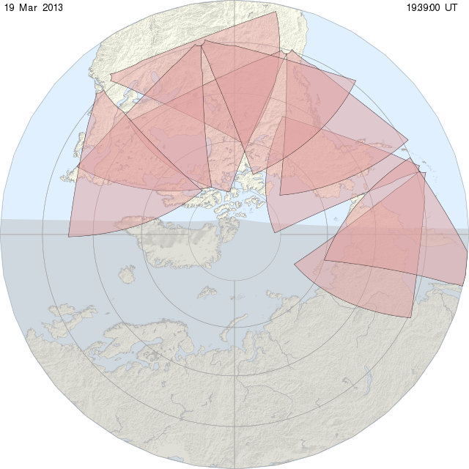
Network of PolarDARN (blue), SuperDARN (green), STORMDARN (red)
Stokkseyri, Iceland
Ionospheric HF radars principle: end of 70s – beginning of 80s
SuperDARN international consortium: beginning of 90s
Involved countries:
South Africa, Australia, Canada, China, France, Italy, Japan, United Kingdom, USA, Finland/Sweden + Poland, Russia…
Northern Hemisphere
Port-aux-Français, Kerguelen
Dôme C East
New network at mid-latitudes (N. Hemisphere) : STORMDARN
Southern Hemisphere

Slide 7
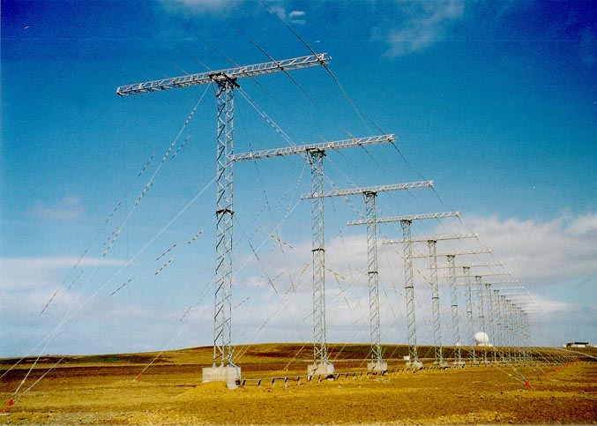
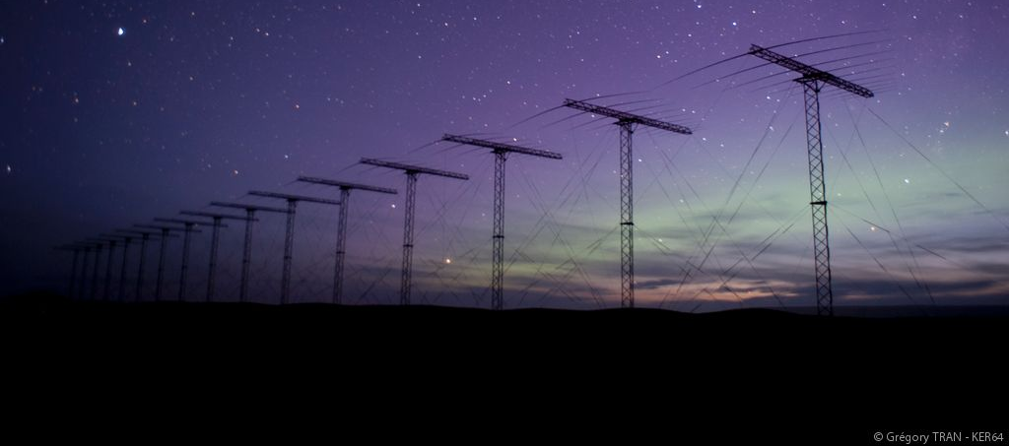
The French SuperDARN radar
Kerguelen radar (IPEV/INSU-PNST)

Slide 8
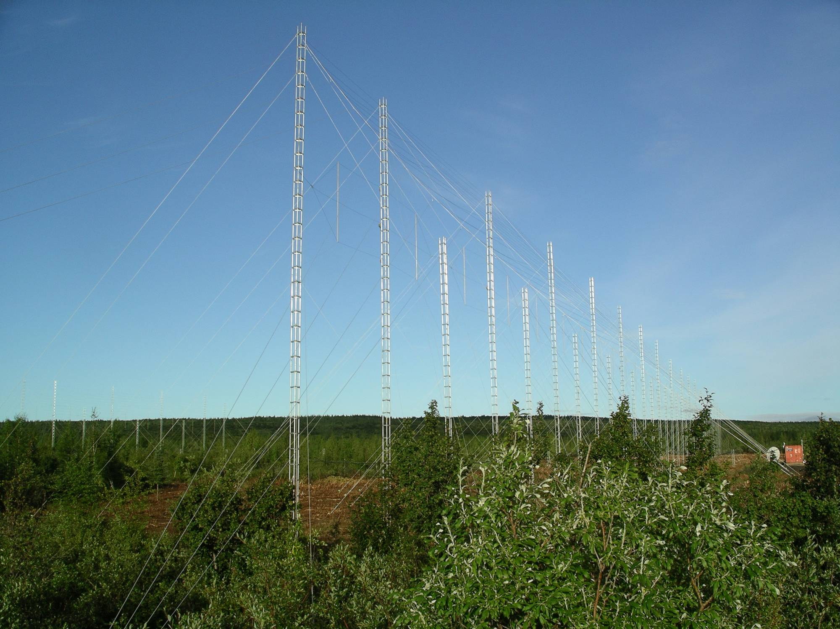
The future Lannemezan radar (UK/Fr)

Slide 9
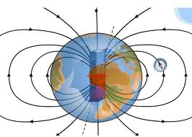
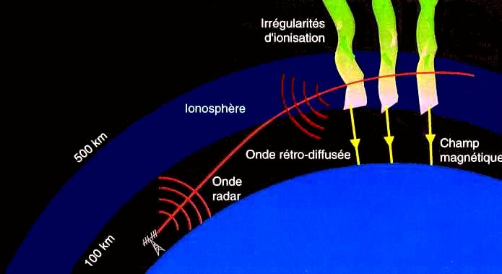
Ionospheric reflection conditions of the radar signal
Specular reflection of the E.M. signal
Targets : irregularities of electronic density aligned to the magnetic field (15-40 m)
Spatiotemporal coherency needed → coherent HF radars
At high latitudes; magnetic field lines almost vertical
E.M. signal in the HF range refracted in the ionosphere
→ Signal can reach the orthogonality condition w.r.t. to the magnetic field and be backscattered to the radar
→ Condition reached in the ionosphere for 100 < alt < 500 km

Slide 10
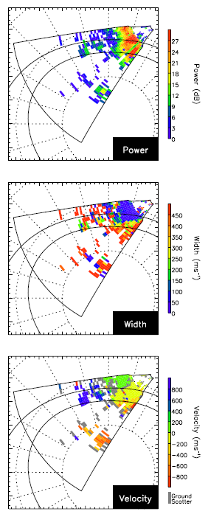
Radar SuperDARN: measured parameters
Parameters measured simultaneously along 75 ranges in distance and successively along 16 beams
  - Radial velocity
  - Spectral width
  power of backscattered signal
Parameters coded in color:
  For radial velocity: away of the radar coded in yellow-red
  toward the radar coded in green-blue
Sun
Radar
North Mag. Pole

Slide 11
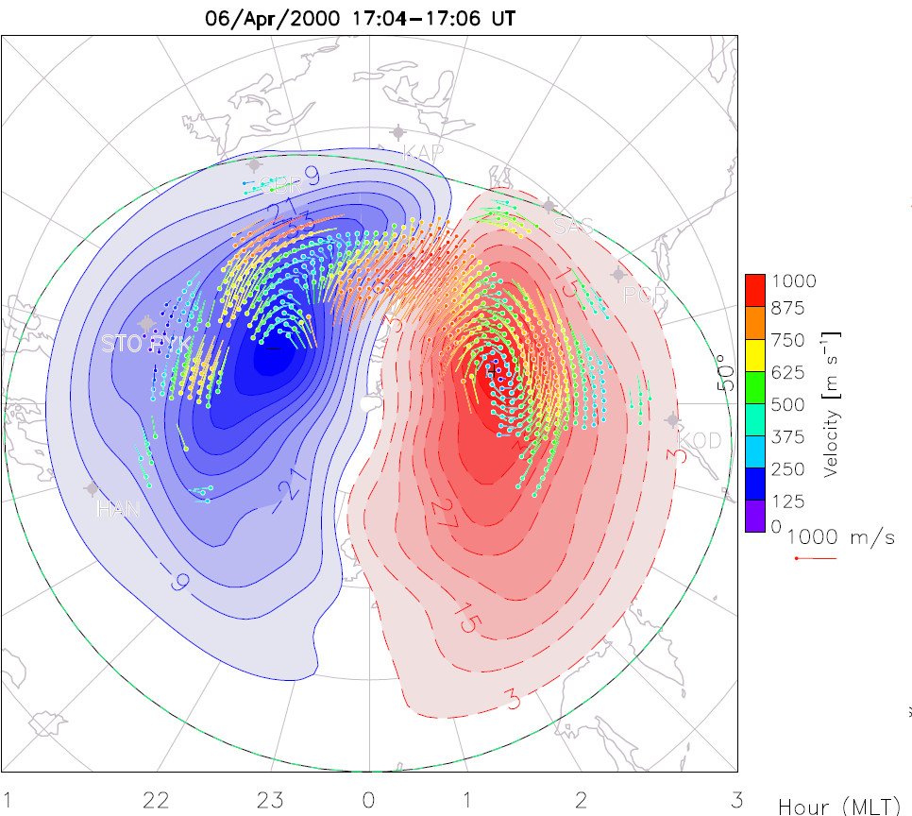
Reconstruction of the global ionospheric convection from the complete set of HF SuperDARN radars
Reconstruction of velocity vectors:
→ obtained from all radar data
→ fitted over a statistical convection model
→ possible reconstruction in each hemisphere
Temporal evolution of the convection
cells dynamics
Continuous measurement of the cross-polar cap potential in each hemisphere
→ proxy of the magnetosphere-ionosphere coupling
→ possibly in real-time
Sun

Slide 12
Plan
Introduction
SuperDARN presentation
Foreseen studies and developments

Slide 13
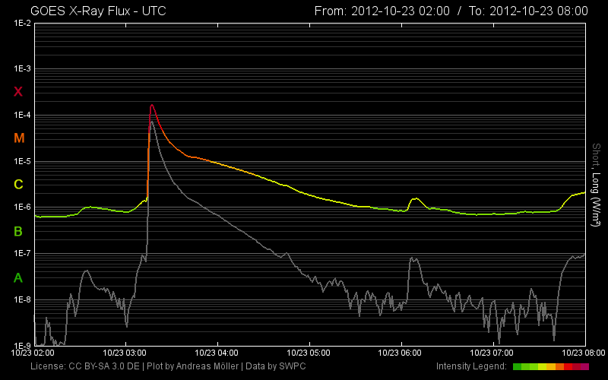
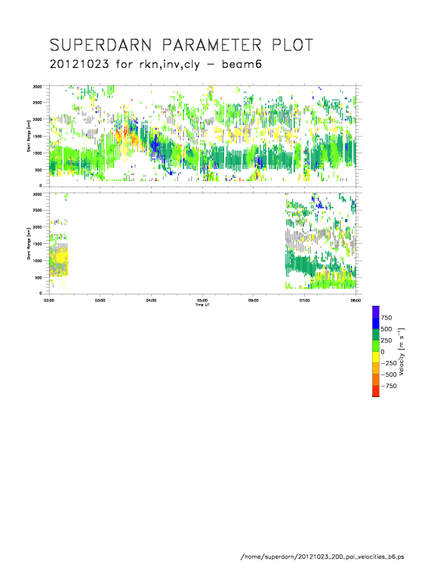
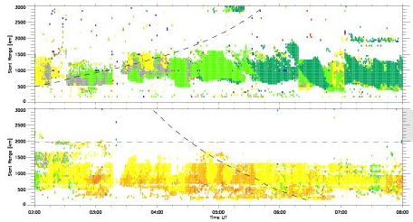
Scientific topics at IRAP (1):
HF Propagation waves during solar flares
Perturbation of HF propagation waves during solar flare
X-flux of the flare as observed with GOES satellites
HF waves propagation as diagnosed by polar SuperDARN radars in both hemispheres
- Northern hemisphere:
→ Velocities echoes displaced to further distance of the radar during the X solar flare
→ Increase of the measured radial velocity
Southern hemisphere:
→ Typical extinction of the SuperDARN echoes during the X-flux maximum
→ Absorption of HF waves in the D region (60 < alt < 90 km)
HN
HS
HS
02:00 03:00 04:00 05:00 06:00 07:00 08:00 UT

Slide 14
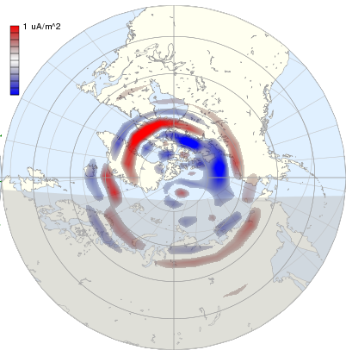
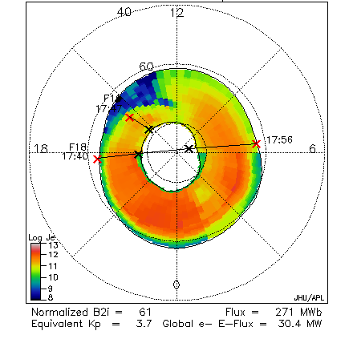

Scientific topics at IRAP (2): Electrodynamics modelling
Data assimilation in the Ionosphere-Magnetosphere model (IMM) describing the electrodynamics
- Assessment loop for magnetospheric inputs-outputs to best fit the measured parameters (ionosphere convection, pattern of precipitation and of field-aligned currents)
→ to deduce electrodynamics parameters not directly accessible (conductivities, ionospheric currents)
→ to get self-consistent electrodynamics inputs for our ionosphere model (IPIM)
Real-time version: available measurements → AMPERE, OVATION, SuperDARN
Search for a PhD student

Slide 15
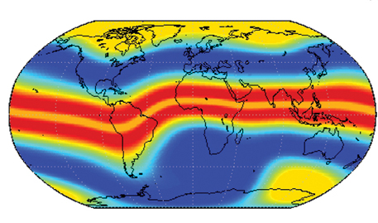
  Scientific topics at IRAP (3): GNSS Tomography with a static ionosphere model
Analysis and interpretation of GNSS signal
Direct approach (instead of usual inversion method) thanks to a numerical model
→ Reconstruction of ionosphere and atmosphere state over a large spatiotemporal coverage
development of s static ionosphere model based on IPIM with a 3D grid (90 < alt < 3000 km)
Constraints on the model by GNSS data feeding
→ Big interest for real-time applications (e.g. Thalès)
Maxime Grandin PhD (Finland-France)– 2014-2017

Slide 16
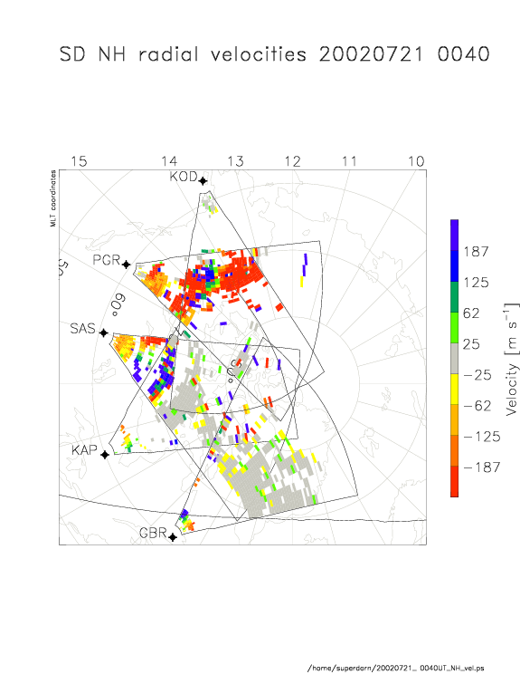
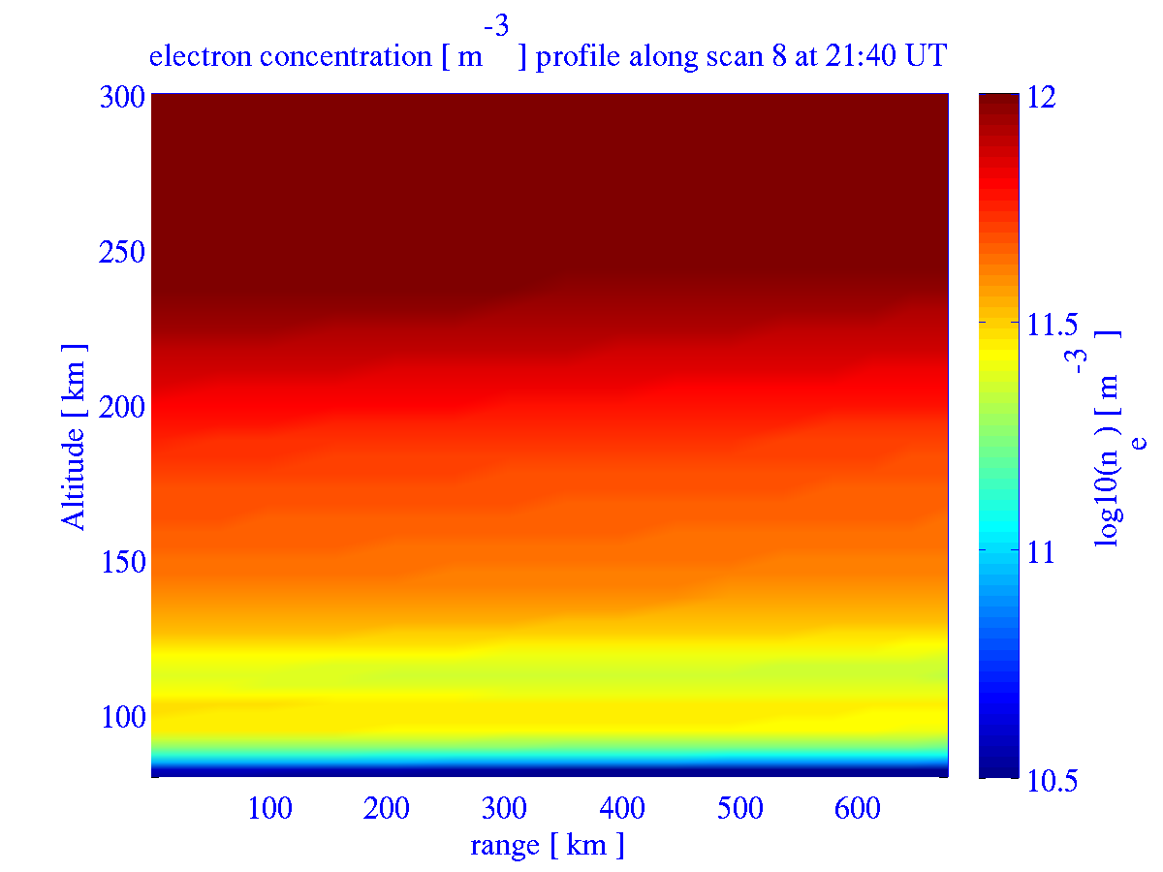
  Scientific topics at IRAP (4): modelling of HF waves propagation in the ionosphere
Development of a numerical model of HF waves propagation: ray path model
Simulation of waves propagation in our ionosphere model IPIM
Adaptation of IPIM outputs to fit the HF radar observations
Possible to use this technics in the static model developed by Maxime for real-time applications (see previous slide)
Sun
→ Reconstruction of the ionosphere state over a large spatial coverage with a temporal resolution of about 1 min
Etienne Foucault PhD (DGA/Thalès)– 2016-2019

Slide 17
Synopsis of the coupled IPIM model
Atmospheric inputs
Magnetic activity proxy
Transport of thermal species
Electrodynamics inputs to develop (high latitudes and equator)
Chemical module
Transport of suprathermal electrons
Marchaudon & Blelly, JGR, 2015

Slide 18
Example of IPIM results: electronic density along a flux tube at L_{max}=2 wrt to MLT for equinox and solstice
North
North
Earth
Sun
Earth
Sun
South
South

