Slide 1
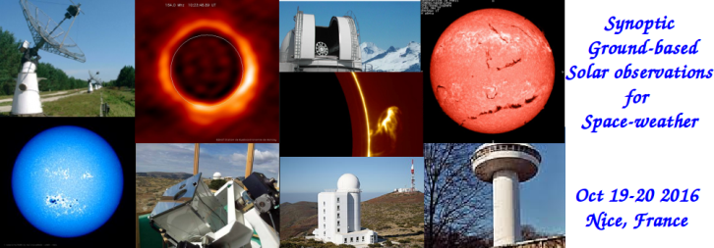
METEOSPACE project at Calern Observatory
D. Crussaire (OP) – F. Morand (OCA)
T. Corbard (OCA) – J.-M. Malherbe (OP)
and all the METEOSPACE team

Slide 2
Scientific goals
Install a set of small telescopes at Calern observatory dedicated to the continuous observation of the chromosphere.
This project will benefit from the existing solar station equipment and staff at Calern observatory.

Slide 3
Scientific goals
Monitoring solar activity both in real time and in the long term are needed for both research and for applications in space weather through the detection of rapid and transient solar phenomena :
instabilities of solar filaments, eruptive filaments being partly associated with the onset of coronal mass ejections (CME) ;
solar flares, also associated with CME ;
chromospheric Moreton wave, also associated with the coronal wave which also appears in the lower corona radio radiation and in the high corona coronographic observations (SOHO / LASCO).

Slide 4
Scientific goals
The hydrogen H line is the most suitable line for monitoring solar phenomena from their birth, low in the solar atmosphere, the chromosphere, the root of solar eruptive activity. Images taken in narrow band filters of Ca II K and Ca II H lines will also complement these observations.
These lines of singly ionized calcium are the strongest absorption lines in the visible solar spectrum and among the most sensitive indicators of the chromospheric structure and magnetic features of the Sun.

Slide 5
LESIA context
Jean-Marie Malherbe
(INSU SO6)
Lionel Birée
(CDAOA)
Recherche en physique solaire
Système opérationnel Prévisions de l’activité solaire
François Ruty
Chef de projet
(LUNA)
LESIA
Daniel Crussaire (OP)
Instruments
Acquisition
Frédéric Morand (OCA)
Infrastructure
Serveur FTP
François Ruty (LUNA)
Algorithmes
Base de données

Slide 6
Budget OP/LESIA
OP loan : 23000 € (possibly up to 30000 €)
OP (DIM ACAV) : ≈ 22000 € HT
OP (PICARD) : ≈ 5000 € HT
DGA :
OCA subcontracting : 48000 € TTC
Components : 38000 € TTC
Missions : 5000 € TTC
Personnel : 36000 € HT
Management fees : ≈ 10000 € HT

Slide 7
Features
Up to 4 refractors (Ø 80 – 102 mm) in a single enclosure up to 180 cm x 50 cm x 50 cm (L x W x H) on a heavy equatorial mount ;
Chromospheric Hα refractor ;
Prominences CaII H refractor ;
CaII K / CH (G) band / CN band refractor using a filter wheel.

Slide 8
Specifications
2208 x 2208 full-disk images ;
2 " (arcsec) resolution ;
12 bits dynamics (4096 real levels) ;
10-sec cadence for Hα, 60-sec cadence for other wavelengths ;
DayStar 0.4 Å for Hα, Barr 1.2 Å (CaII H/K) or 8 Å interference filters for other wavelengths ;
CCD Sony ICX694 2758 x 2208 sensors with 4.54 x 4.54 µm² square pixels.

Slide 9
Optical designs (Hα refractor)
1st option : afocal design
2nd option : telecentric design

Slide 10
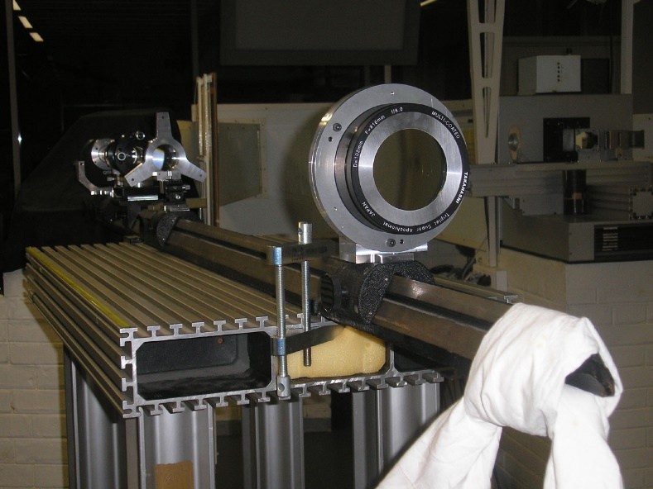
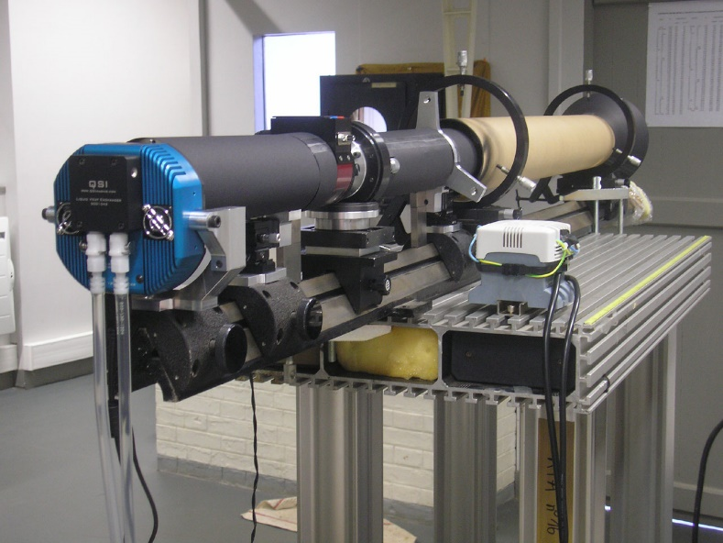
Hα afocal prototype

Slide 11
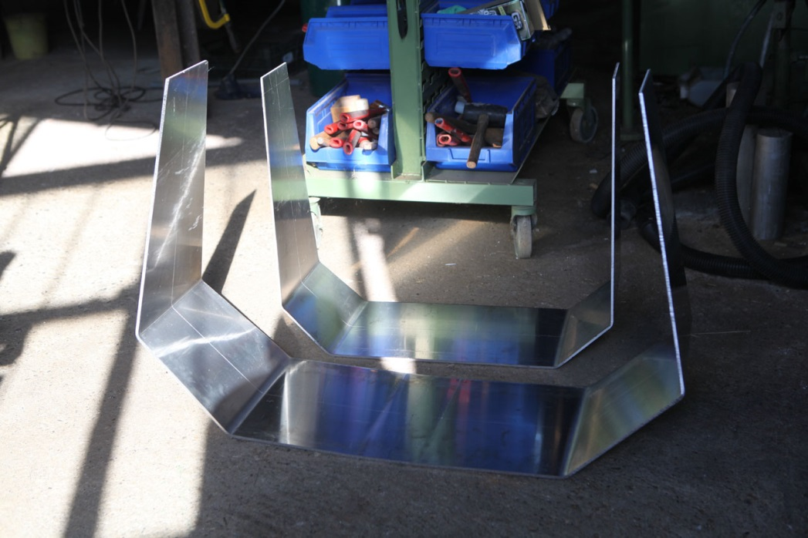
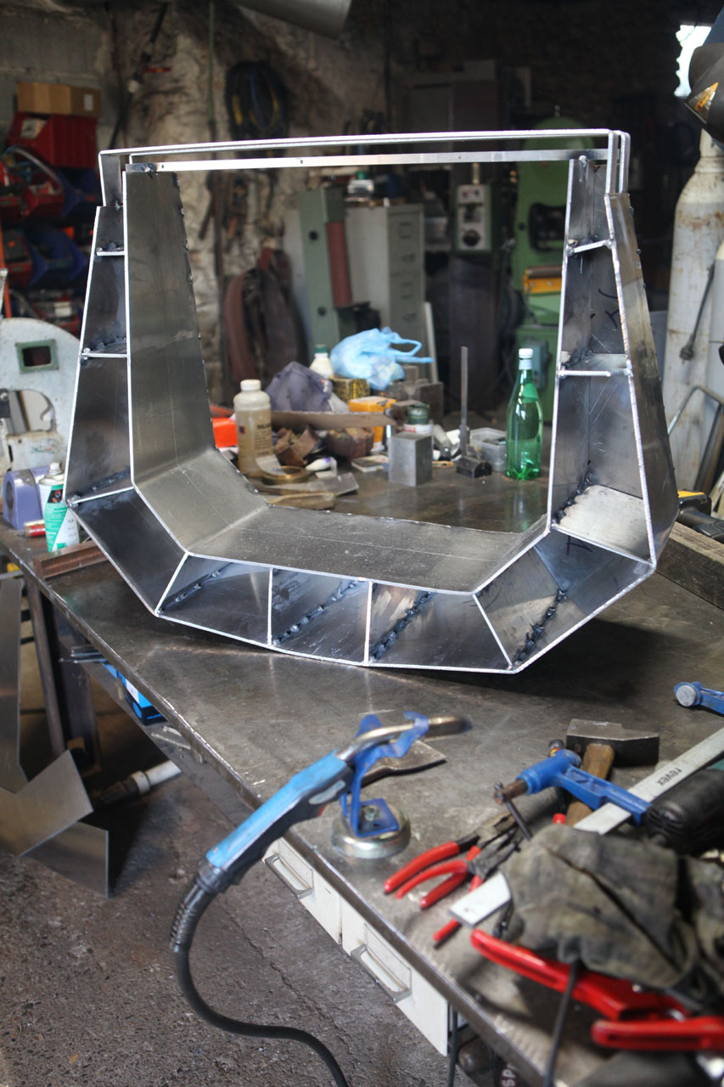
Equatorial mount
In Valméca workshop at
Puimichel near Manosque

Slide 12
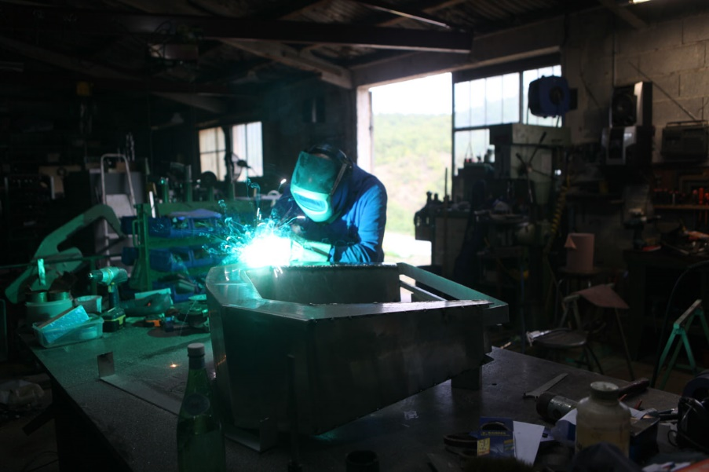
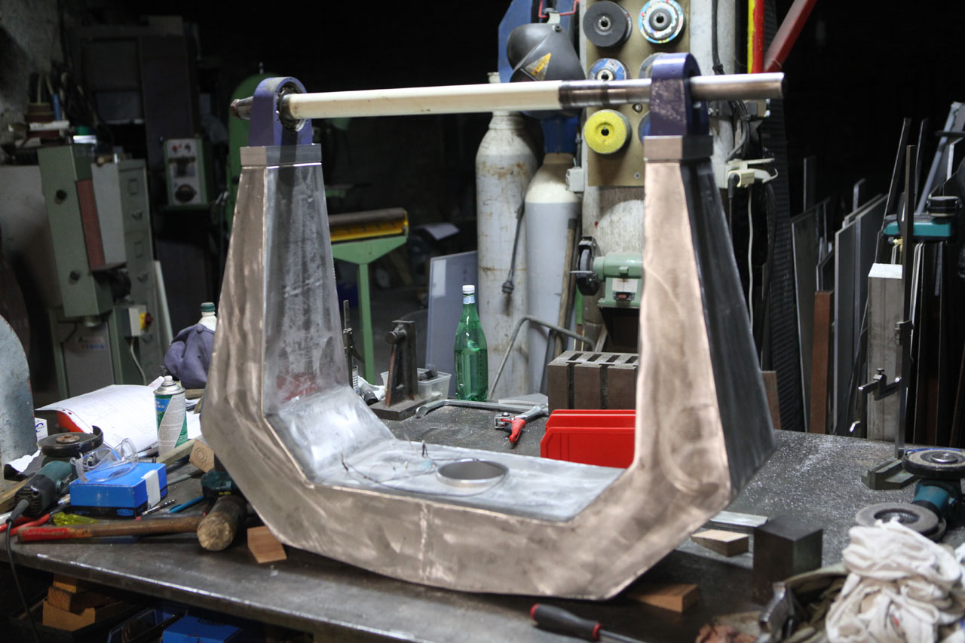
Equatorial mount
Making of the
heavy duty fork

Slide 13
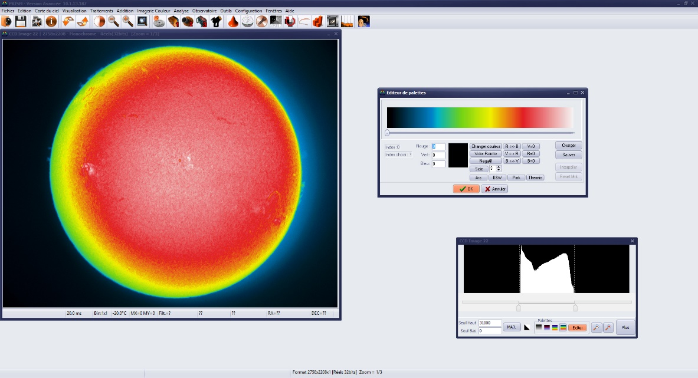
Very first images

Slide 14
Installation at Calern Observatory
Building as small as possible : about, 3 m * 3 m, with 1.50 m height concrete walls and a removable roof. (40 k€)
Implemented near PICARDSOL building → no new control room needed.
Fully motorized and automated opening and closing : weather station, rain sensor, clouds sensor, …
365 days per year of observations as no observer is needed.

Slide 15
« Artist » view of the building (1/2)

Slide 16
« Artist » view of the building (2/2)

Slide 17
Data reduction, storage and distribution
CALERN
NICE
Instruments
ftp
Database
OP /
BASS2000
Main
PC
Data reduction
LUNA
Web
Computation / Database …
Operational service
Scientific
community

Slide 18
Staff
OP / LESIA
Jean-Marie Malherbe
Daniel Crussaire
Denis Ziegler
Alain Docclo
Régis Le Cocguen
Jean Aboudarham
Christian Renié
Nicolas Fuller
Isabelle Bualé
OCA
Thierry Corbard
Frédéric Morand
Catherine Renaud
Marianne Faurobert
Bertrand Chauvineau
Fabrice Ubaldi
Alain Anglade
Rodrique Terrochaire
Jacques Depeyre
Alain Gomez
Philippe Bruneau
LUNA
François Ruty
+ 2
DGA
Lionel Birée
About 10 FTE during the 3 years development phase

